Slide 1
Northrop Grumman Five DOF Robotic Drilling Arm for Launch Vehicle Components
NAU NG Drill Arm Team
Brandon Knutson, Mica Nellis, Daniel Cooke, Mason Goodman, Russel Stringham, Isaiah Padilla

Slide 2
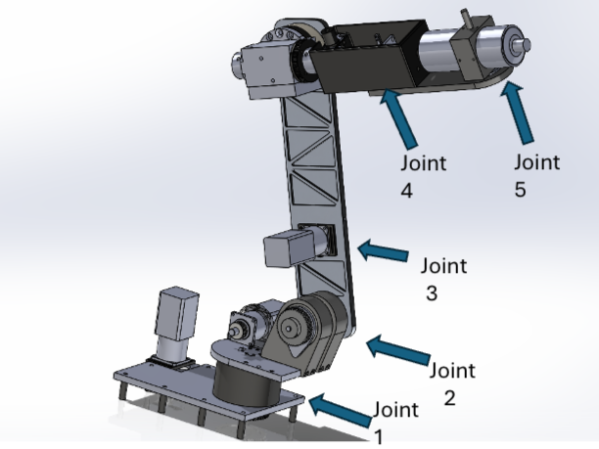
Project Description
The NAU engineering team is designing a robotic drilling arm that is required to perform various tasks that include but not limited to, being human input responsive, drilling through composite materials, and various bolt clearances.
Various concepts considered and eventually ruled out through Failure Modes and Effects Analysis (FMEA) and testing, as well as Most Viable Product and benchmarking different subsystems within the design.
5 DOF robotic drilling arm was created to meet all customer and engineering requirements to ensure the success of the design.
Joint Task:
Joint 1: Base axis of the robot allowing for movement left to right
Joint 2: Allows robotic arm to move forward and backwards in x-direction controlling the
lower half
Joint 3: Provides robots the ability to move in x-axis controlling upper arm allowing for
vertical reach
Joint 4: End-effector location allowing “wrist” to rotate
Joint 5: End-effector drilling rotation
Most Viable Product/Success Metrics:
Drill hole through composite material
Run on household appliance power access (no hydraulics)
Cost Effective
Portable and device will be locked into place

Slide 3

Course and Client Deliverables
Course Deliverables
Task | Date of Completion
33% Manufactured/67% Purchased | 2/7/2024
67% Manufactured/100% Purchased | 2/27/2024
UGRAD’s Registration | 3/7/2024
100% Manufactured and Purchased | 3/26/2024
Finalized Testing Plan and Demo | 4/16/24
Final CAD/BOM/Wiring Diagram | 4/12/2024
Website Completion | 4/21/2024
UGRAD’s Symposium | 4/26/2024
Client Deliverables
Task | Date of Completion
Biweekly Client Meetings | Duration of Semester
CDR Presentation | 3/8/2024
Northrop Grumman Design Day | 5/2/2024

Slide 4
Design Requirements Summary
Fully Autonomous​:
User should be able to use control system to select a preprogrammed setting for the desired job.​
E-stop that can detect overheating or system malfunction and automatically shut down.​
Mobility:
System should be on wheels, capable of being moved by no more than two people for placement.
System will be locked in place.
Other:
Cost effective: Low product and maintenance costs.
Must be able to work continuously through a 10 -hour workday.
Strictly electronic running on standard household appliance power access (no hydraulics).
​
Customer Requirements:
CR1 - Working Volume (50” D x 4’ Height)
CR2 – ¼” Aluminum Drilling
CR3 - Human Input Responsive (HIR)
CR4 – 0.003” Drilling Tolerance
CR5 – Portable
CR6 – Electrical Power
CR7 – Emergency Stop
CR8 – Cost Efficient
Engineering Requirements:
ER1 – Deflects < 0.1” During Drilling
ER2 – Spindle Speed 3,000 RPM
ER3 – Motor Torque 100 N-m
ER4– Human Input Responsive
ER5 – Assembly < 150 lbs

Slide 5
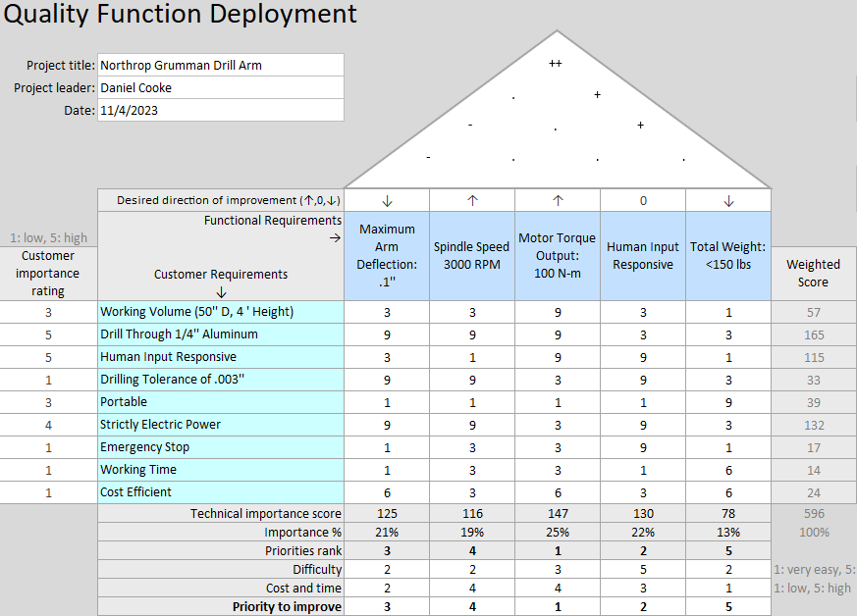
QFD
Functional Priorities
All motors output the required amount of torque to their respective joints.
The programmable system is capable of taking human input in the form of cylindrical coordinates to reach the desired hole location.
Secondary Priority
In order to reach the desired drilling tolerance of .003’’, the complete assembly must be deflection resistant.

Slide 6
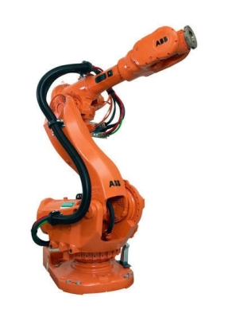
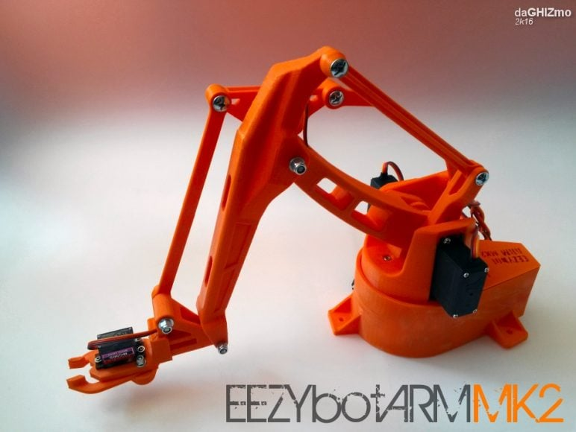
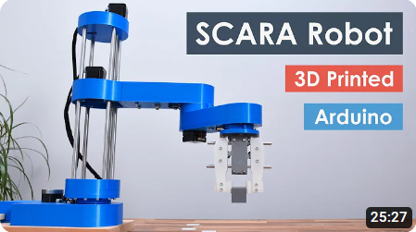
Benchmarking
The first benchmarking was viewed for inspiration on a 6DOF robotic arm implementation [1].
The second benchmarking was used to provide visual guidance on a different implementation of a 6DOF robotic arm [2].
The third benchmarking was used to reference a robotic arm implementation that did not have 6DOF [3].

Slide 7
Literature Review – Isaiah Padilla
Online Resources:
M. Fairchild, “Drilling robots: Automate for fast and precise results,” #HowToRobot, https://howtorobot.com/expert-insight/drilling-robots (accessed Sep. 15, 2023).
Provides what industries are already using drilling robots
Main uses for various robots in the industry
Provides potential outreach opportunities for not only more advice but as well as donated materials
T. Xometry, “Drilling machines - parts, types, and uses,” Xometrys RSS, https://www.xometry.com/resources/machining/drilling-machines/ (accessed Sep. 15, 2023).
Shows different "parts of a drilling machine, the different types of machines available, and the specific uses of these machines"
Will be helpful in the same ways stated above but also help break down the parts of a drilling machine
“A-Z guide for Drilling Aluminium | RUKO Shop UK,” RUKO UK, Nov. 07, 2023. https://ruko.shop/blogs/ruko-shop-blog/drilling-aluminium-guide#:~:text=A%20regular%20HSS%20drill%20bit
Used for direction on what materials and torques are best for drilling through aluminum
Matthew, “The Difference Between HSS and Cobalt Drill Bits,” R.D. Barrett, Nov. 20, 2019. https://rdbarrett.co.uk/blog/the-difference-between-hss-and-cobalt-drill-bits/
Used to help inform a decision on which material to use for the selected drill bit
‌“How to Find the Right High-Speed Spindle | Spindle Tooling,” www.ibagnorthamerica.com. https://www.ibagnorthamerica.com/blog/how-to-select-the-right-high-speed-spindle (accessed Oct. 10, 2023).
‌ Provides insight on what selection criteria should be used when selecting a high speed spindle for a job
Books:
R. G. Budynas and J. K. Nisbett, “Chapter 9 - Welding, Bonding, and the Design of Permanent Joints,” in Shigley’s Mechanical Engineering Design, 11th edition, SI units, 11th ed, S.l., NY: MCGRAW-HILL EDUCATION (AS, 2020, pp. 485–612
Allows for the team to have a solid idea in how to bond, fasten, and connect each piece to our robotic drilling arm
R. G. Budynas and J. K. Nisbett, “Chapter 4 - Deflection and Stiffness,” in Shigley’s Mechanical Engineering Design, 11th edition, SI units, 11th ed, S.l., NY: MCGRAW-HILL EDUCATION (AS, 2020, pp. 173–219
Calculate how the team’s robotic arm will react when experiencing high amounts of torque during drilling.
Papers:
G. R. Reddy and V. K. Eranki, “Design and Structural Analysis of a Robotic Arm,” thesis, Karlskrona, 2016
Helps in creating "joints that move in vertical and horizontal directions"
R. Gautam, A. Gedam, A. Zade, and A. Mahawadiwar, Review on Development of Industrial Robotic Arm. International Research Journal of Engineering and Technology, 2017
Shows how to create a robotic arm that is "lightweight and uses lightweight materials"
M. Z. Silva, T. Brito, J. L. Lima and M. F. Silva, "Industrial Robotic Arm in Machining Process Aimed to 3D Objects Reconstruction," 2021 22nd IEEE International Conference on Industrial Technology (ICIT), Valencia, Spain, 2021, pp. 1100-1105, doi: 10.1109/ICIT46573.2021.9453596.
Will be useful when considering the portability of the design
Another viable resource in G-Code 3D visualization software important in the drilling aspect of the project

Slide 8
Literature Review – Brandon Knutson
BOOKS
R. C. Hibbeler, ENGINEERING MECHANICS : dynamics. Pearson, 2018.
R. G. Budynas, J Keith Nisbett, and Joseph Edward Shigley, Shigley’s mechanical engineering design. New York, Ny: Mcgraw-Hill Education, 2020.
PAPERS
K. F. Tamrin, N. A. Sheikh, and S. M. Sapuan, “7 - Laser drilling of composite material: A review,” ScienceDirect, Jan. 01, 2019.https://www.sciencedirect.com/science/article/pii/B9780081023976000076#f0010 (accessed Sep. 15, 2023).
A. Haidar, C. Benachaiba, and M. Zahir, “Software interfacing of servo motor with microcontroller,” Faculty of Engineering and Information Sciences - Papers: Part A, pp. 84–99, Jan. 2013, Available: https://ro.uow.edu.au/eispapers/468/
G.-S. Huang, C.-K. Tung, H.-C. Lin, and S.-H. Hsiao, “Inverse kinematics analysis trajectory planning for a robot arm,” IEEE Xplore, May 01, 2011. https://ieeexplore.ieee.org/document/5899203?denied= (accessed Sep. 15, 2023).
ONLINE RESOURCES
“Simulator for industrial robots and offline programming - RoboDK,” robodk.com. https://robodk.com/
“Jeremy Fielding – All Things Mechanical,” Jeremy Fielding. https://jeremyfielding.com/ (accessed Sep. 15, 2023).
“RCTESTFLIGHT,” RCTESTFLIGHT. https://www.rctestflight.com/ (accessed Sep. 15, 2023).
tec-science, “How does a cycloidal drive work?,” tec-science, Jan. 14, 2019. https://www.tec-science.com/mechanical-power-transmission/planetary-gear/how-does-a-cycloidal-gear-drive-work/

Slide 9
Literature Review – Daniel Cooke
Books
“Gears- General,” in Shigley’s Mechanical Engineering Design
This source describes gear and shaft design. It discusses the design of worm gears, gear trains, and how to do a force and torque analysis on the gear and shafts that drive them.
“Mechanical Properties of Metals”
This source details the properties of metals, including strengths, failure tendencies, and treatment methods. The holes made in the drilling process must not exceed a tolerance of .003 inches which requires very precise drilling. If the drill bit is not rotating at a precise speed with the correct torque and force applied, it would be quite easy to exceed that tolerance.
Standard Handbook for Mechanical Engineers
This handbook includes useful chapters that discuss machine design, gear design, heat transfer, mechanics of materials, along with any other relative literature that could be utilized by the team.
“Chapter 8: Deflection of Beams,” in Mechanics of Materials
It is essential to select an arm shape and material that will not deflect under static loading, as well as during the drilling operation. This chapter of mechanics of materials aided in the calculation of deflection for the aluminum that will be used in the final build of the product.
Online Resources
“Fast and ‘soft-arm’ tactics,”
A section titled "Kinematic Arm Movement” discusses all aspects of the design and mathematical modeling behind selecting arm shape, material, and dimensioning.
“Software development for 3D visualization of G-code when working with CNC machines,”
Details the process of coding robotics in 3D spaces. While this primarily discusses the applications for CNC machines, which utilize cartesian coordinates, it still contains useful procedures that can be applied to a cylindrical coordinate system which this project uses.
“What is manufacturing & Manufacturing Processes”
This website details methods and procedures of the manufacturing side of engineering design. It discussed the manufacturing processes of metal parts for various intended uses. This resource will be used by the team if there is a part that cannot be found for purchase.
McMaster-Carr
McMaster-Carr offers parts files and design specifications for all their products, which would allow the team to upload the part used for assembly rather than designing it.
“Speed - torque curves for Stepper Motors,”
This source discusses power supply selection, and how to optimize the torque output of a stepper motor.

Slide 10
Literature Review – Mason Goodman
Online Resources:
Design of Geometric-Based Inverse Kinematics for a Low-Cost Robotic Arm - M. A. Muslim and S. N. Urfin
“Design of Geometric-Based Inverse Kinematics for a Low-Cost Robotic Arm” informs readers on typical calculations needed to effectively control the end effector of a robotic manipulator.
The Demeter Project - How to Create a Robotic Arm With Your Students
The “Demeter Project” is a step-by-step course that details the creation of a simple robotic arm.
“Simplify Robot Programming with G-code - Universal Robots,”
Universal Robots is a massive online resource with information regarding robotics across various industries and applications. .
“Appendix E: Creating the validation plan with a validation requirements matrix,” NASA, https://www.nasa.gov/reference/appendix-e-creating-the-validation-plan-with-a-validation-requirements-matrix/ (accessed Nov. 29, 2023).
Northrop Grumman has tasked the capstone group with creating a validation plan for the final design in congruence with the Customer Requirements.
P. Eskofier, “Drv8825 Adjust stepper current,” my home fab, https://www.my-home-fab.de/en/documentations/technical-descriptions/drv8825-adjust-stepper-current (accessed Nov. 14, 2023).
Books/Papers:
Springer Handbook of Robotics: With 84 Tables
The Springer Handbook of Robotics provides an overview of robotic design providing group understanding relating to engineering requirements and overall goals of the robotic arm. The handbook details an introduction to forward and inverse kinematics that will provide insight toward the dynamic movement of team designed arm.
Chapter 11 – Implementation, in Engineering by design
“Chapter 11 of Engineering by Design” explores the quality, reliability, and maintainability of engineering design throughout the iterative construction process.
Development of Robotic Arm Prototype - A. Chaudhari, K. Rao, K. Rudrawar, P. Randhavan and P. Raut,
The “Development of a Robotic Arm Prototype” paper details the design of a simple robotic arm containing three small servo motors powered by an Arduino board. At a fundamental level this design has very much in common with the proposed team design.
A Review of Current Techniques for Robotic Arm Manipulation and Mobile Navigation - T. Sieusankar and B. Chandrasekaran, T. Sieusankar and B. Chandrasekaran

Slide 11
Literature Review – Mica Nellis
“Failure Resulting from Static Loading,” in Shigley’s Mechanical Engineering Design
This chapter considers relations in strength and such static loading mentioned before and how to make decisions regarding material choice and reliability. This chapter was chosen because it helped the team avoid failures regarding static loading. This robotic drilling arm will be quite large and heavy so the proper material choices, fabrication, and load types was a key factor to be considered.
“Power Transmission Case Study,” in Shigley’s Mechanical Engineering Design
discusses different power transmission cases and how to incorporate gears, bearings, and shafts into a design proving that each of these concepts are not independent. All the outlines in these studies will help the team find clarity in logical design sequences and how each part affects the overall design.
Performance Analysis of 7-DOF Robotic Arm for Drilling and Milling Applications
This article also discusses performing drilling as well as milling operations by using a robotic arm which is the goal for the team’s design
“McMaster-Carr.”, XL Belts
The use of McMaster-Carr always proves to be helpful allowing for CAD models and calculations to be used.
“Modeling of Robotic Drilling.”
This source proposes two different robotic drilling models that may help improve stiffness and circularity issues. This article also analyzes the static behavior of a robotic arm while drilling which will help the team because having any issues when we the robotic arm is performing the drilling operations that it is tasked with cannot happen
“Implicit force and position control to improve drilling quality in CFRP flexible robotic machining”
This source discusses flexibility but specifies the drilling tip. Although this source can be used only in one area of the project, the drilling operation is most important during the competition
“Annin Robotics”
This source allowed for guidance on the entire robotic design. All information from this site proved to be helpful when building our robotic drilling arm.
“Stepper Online”
This website provides specification sheets for different components of their products. These sheets allowed for accurate CAD models to be created as well as understanding if the motors would work for the intended application

Slide 12
Literature Review – Russel Stringham
ASME Y 14.24 - 2012
The standard ASME Y14.24 - 2012 is an engineering document from the American Society of Mechanical Engineers (ASME) that provides guidelines for the creation of engineering drawings and related documents.
Fancu Arc Mate 0iA Robot
This website was used for benching in this project. Robots.com provides information about the Fanuc ARC Mate 0iA robot. This robot is designed for arc welding applications and features a 3 kg payload and a reach of 1437 mm. The robot is lightweight and compact, making it ideal for welding applications that require high speed and accuracy.
ABB IRB 1600ID Robot
This source was also for benchmarking, and it provides information about the ABB IRB 1600ID robot. This robot is designed for arc welding perfection and features a 4 kg payload and a reach of 1500 mm. The robot has a repeatability of 0.02 mm and weighs approximately 250 kg.
High Quality Equipment and Tool with Unbeatable Price
This website is for benchmarking the drill portion of the project. Vevor.com provides information about the Vevor Magnetic Drill 1400W 2922lbf/13000N Portable Mag Drill Press.
McMaster Carr
This resource was used for getting CAD part files for the parts the team purchased. These part files made a more accurate final CAD model.
Chapter 12 – Lubrication and Journal Bearings, Shigley's Mechanical Engineering Design
This chapter covers several topics like the design of journal bearings, including the selection of bearing materials, the calculation of bearing dimensions, and the analysis of bearing performance.
Chapter 20 – Geometric Dimensioning and tolerancing, Shigley's Mechanical Engineering Desing
The chapter details topics such as the principles of geometric dimensioning and tolerancing, the symbols used in geometric dimensioning and tolerancing, and the application of geometric dimensioning and tolerancing to engineering drawings.
ASME Y 14.5 - 2009
The document ASME Y14.5-2009 is a standard that provides guidelines for dimensioning, tolerancing, and related requirements for use on engineering drawings and in related documents. This standard is considered the authoritative guide for the language of geometric dimensioning and tolerancing.
ASME Y14.100 - 2004
The standard ASME Y14.100-2004 establishes the essential requirements and reference documents applicable to the preparation and revision of engineering drawings and associated lists. It provides guidelines for the preparation and revision of engineering drawings and associated lists.

Slide 13
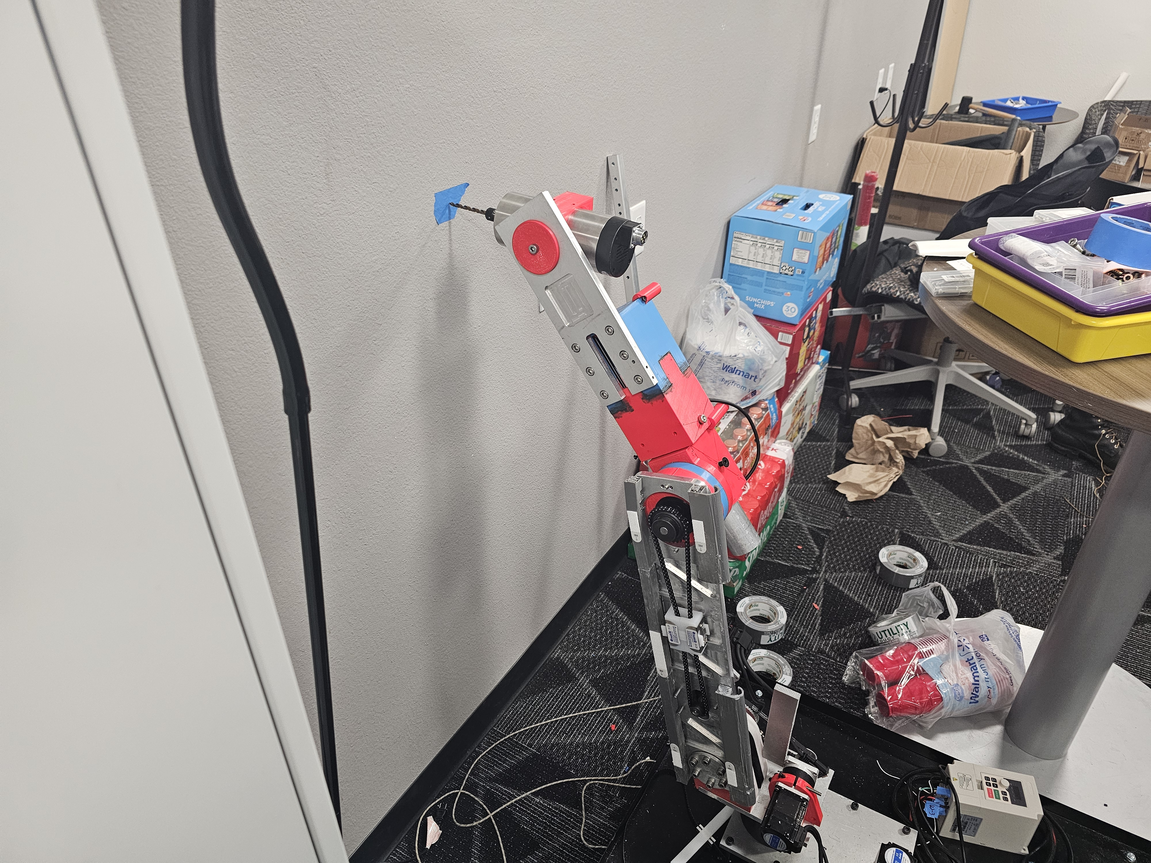
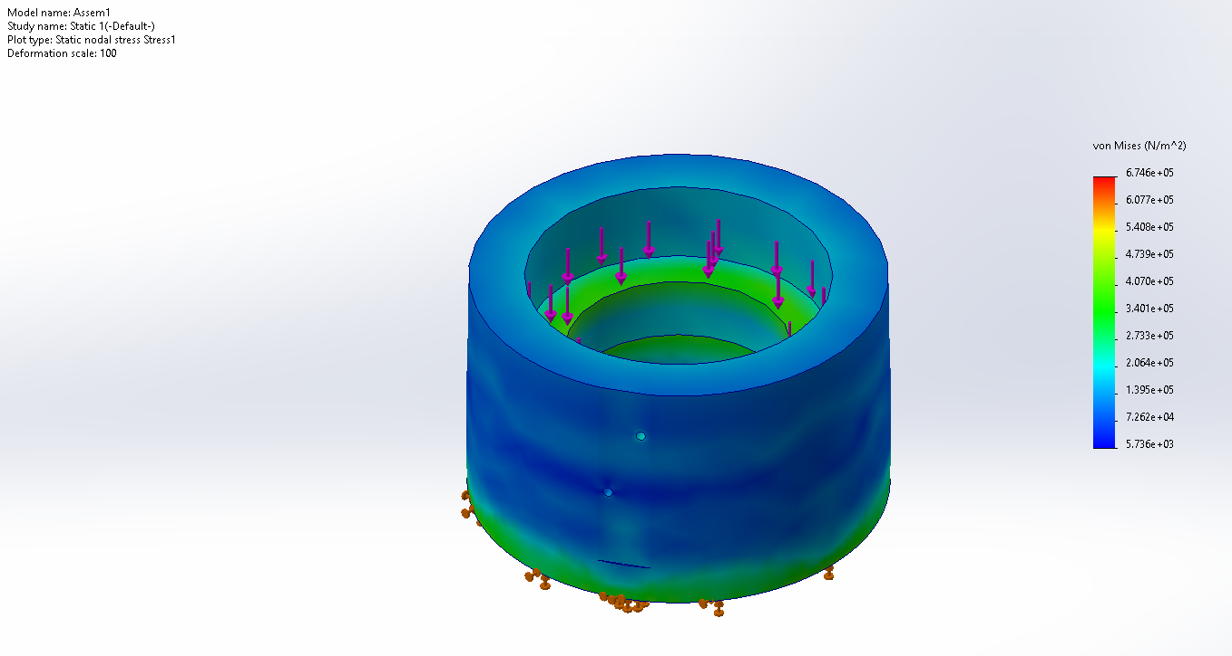
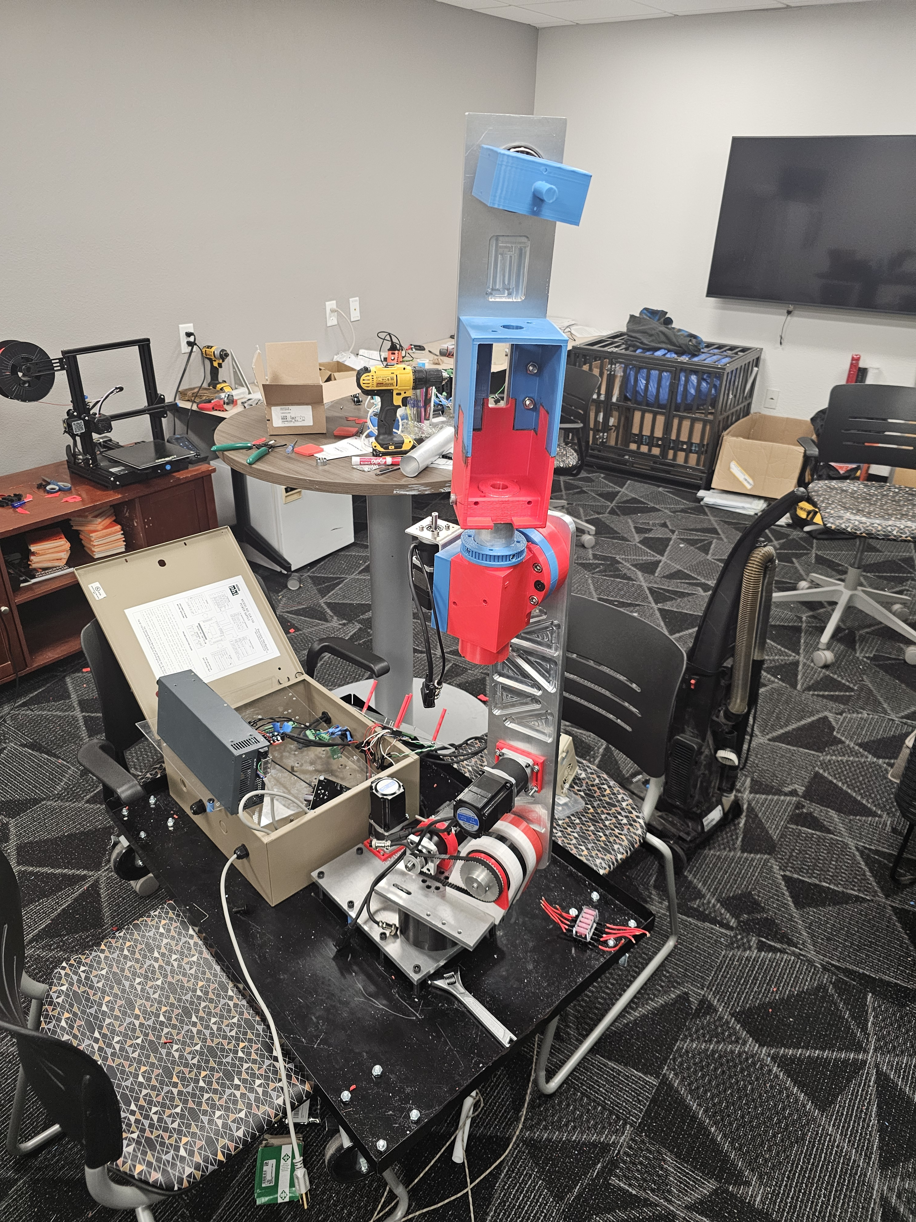
Mathematical Modeling – Joint 1 - Brandon Knutson
Bearing Radial and Axial Load far exceeded Requirements
3D Printer Structure meet Load Requirements
Same can be said for the spindle
All components exceeded a FOS of 10 with a load case of 250lbs

Slide 14
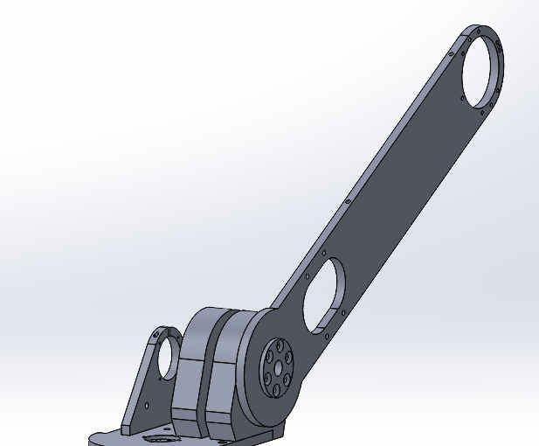
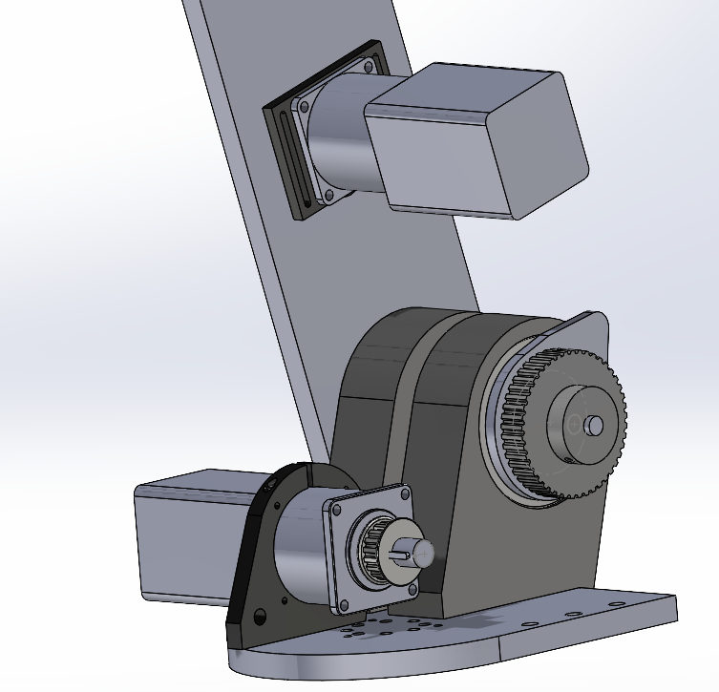
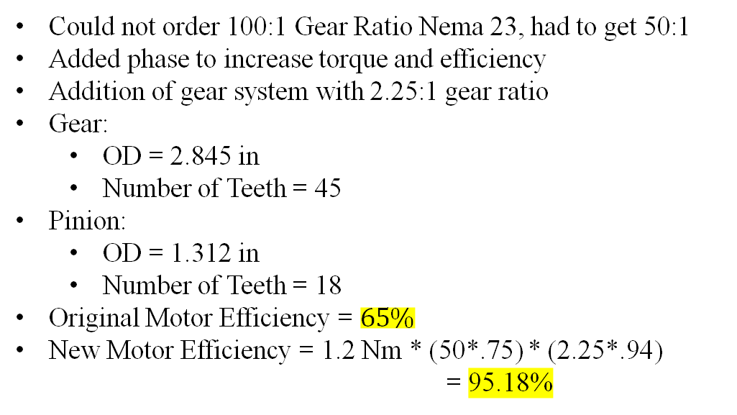
Mathematical Modeling – Joint 2 – Mica Nellis
Could not order 100:1 Gear Ratio Nema 23, had to get 50:1
Added phase to increase torque and efficiency
Addition of gear system with 2.25:1 gear ratio
Gear:
OD = 2.845 in
Number of Teeth = 45
Pinion:
OD = 1.312 in
Number of Teeth = 18
Original Motor Efficiency = $65\%$
New Motor Efficiency = 1.2 Nm * (50*.75) * (2.25*.94)
= 95.18%
Old Design
New Design
Addition of gear system

Slide 15
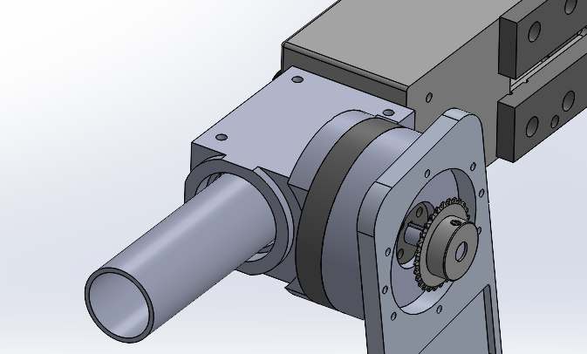
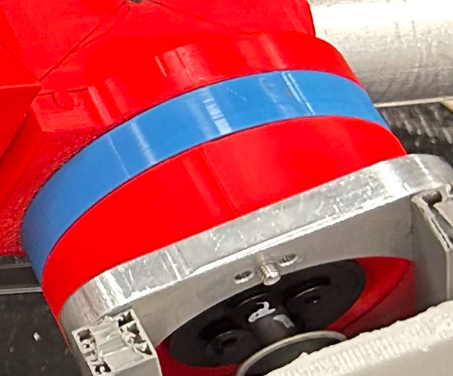
Mathematical Modeling – Joint 3 – Russel Stringham
Initial Testing with FEA Provided confidence with manufacturing J3's spindle and bearing cup out of PLA.
The FEA also showed the key shaft being steel gave better results for the movement beyond J3.
Spindle
Key Shaft
Key Shaft
Bearing Cup
Bearing Cup
Spindle

Slide 16
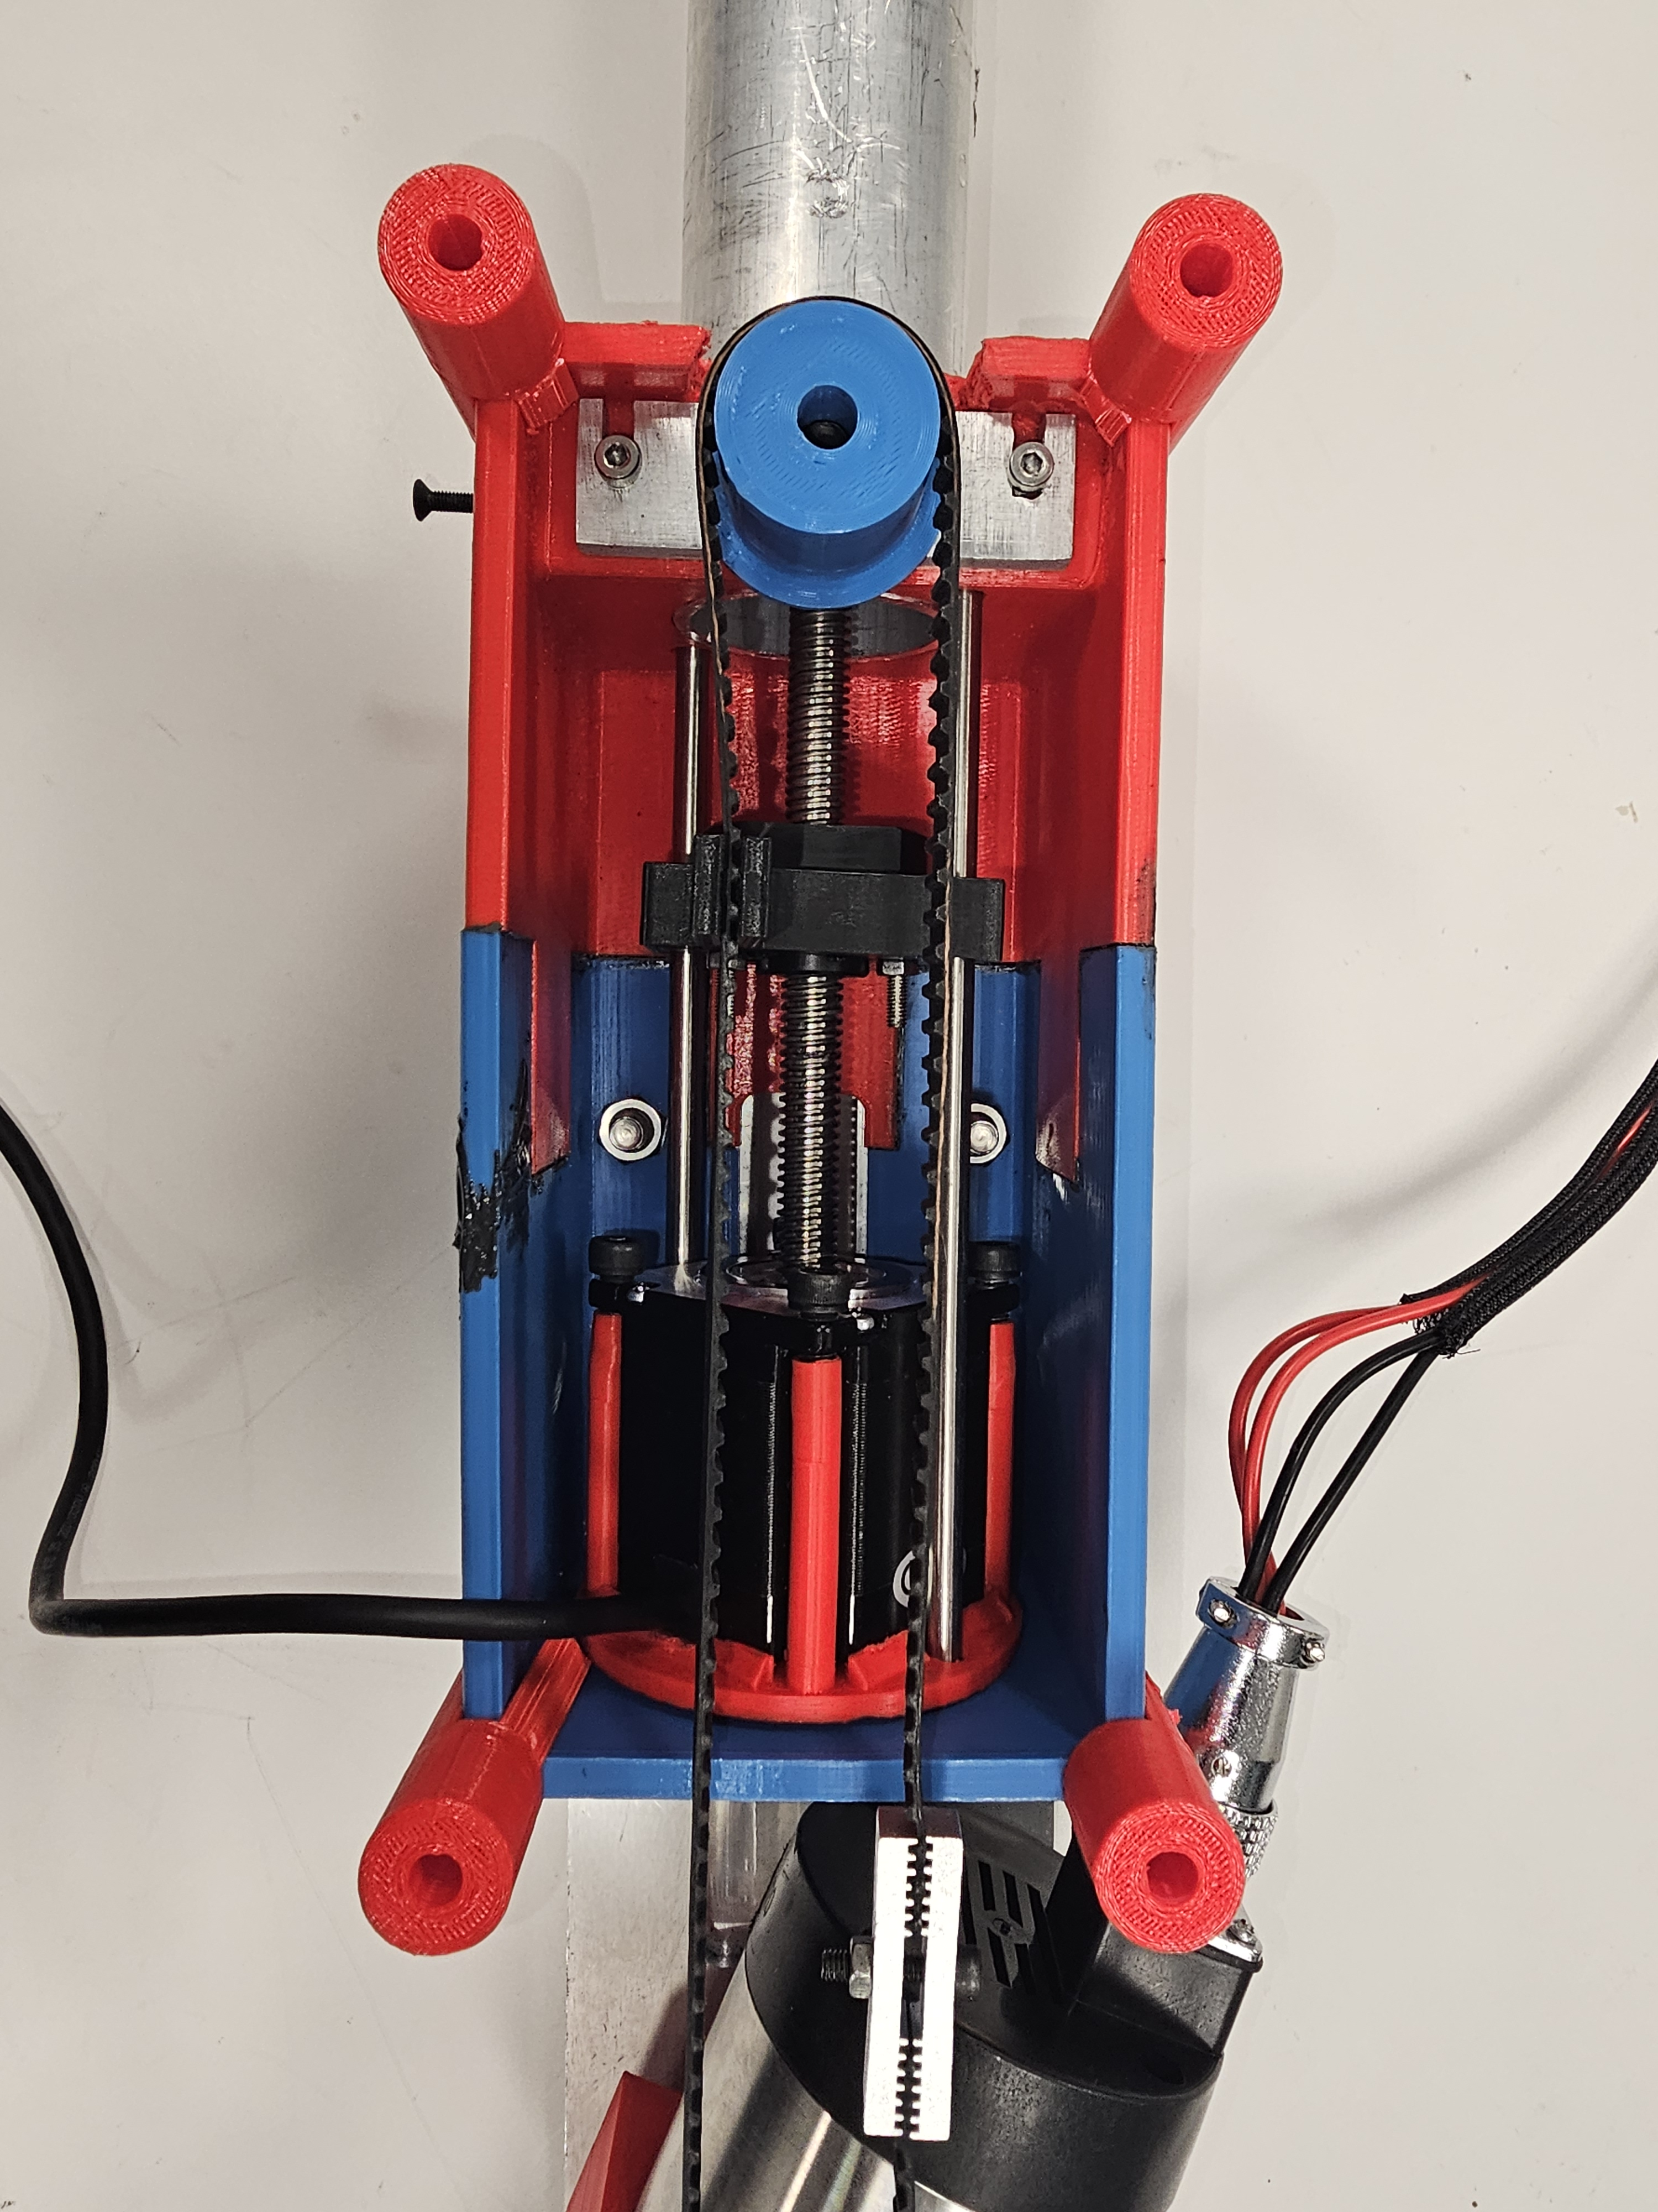
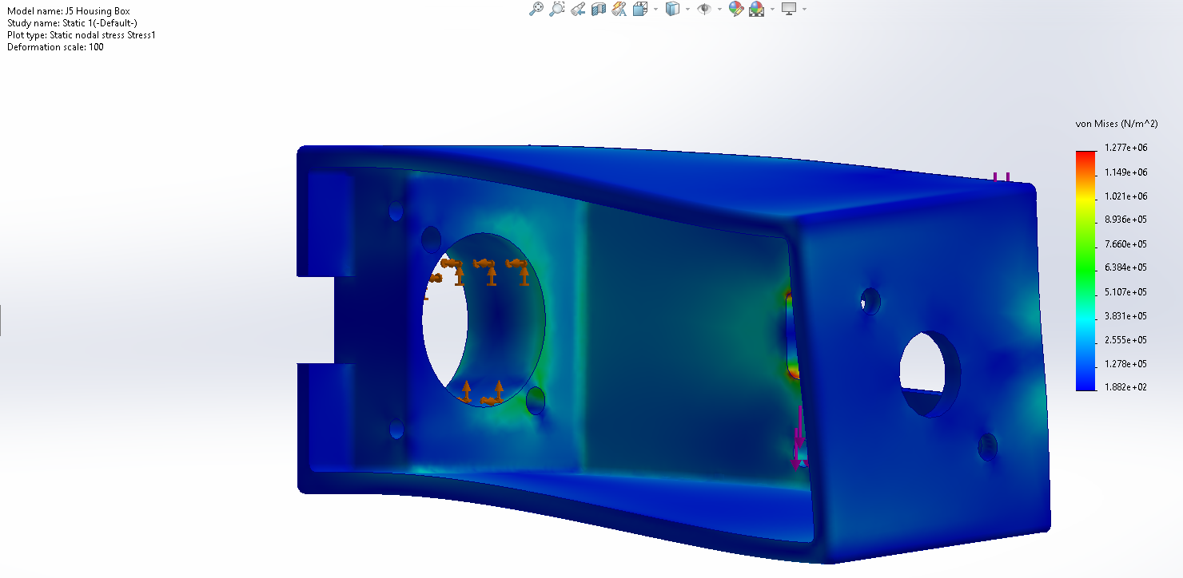
Mathematical Modeling – Joint 4 – Brandon Knutson
J4 Housing Weight
671 Grams PLA Version
1451 Grams Aluminum Version
780 Gram Difference
Deflection Skill Stays Minimal With a
3D Printed Construction

Slide 17
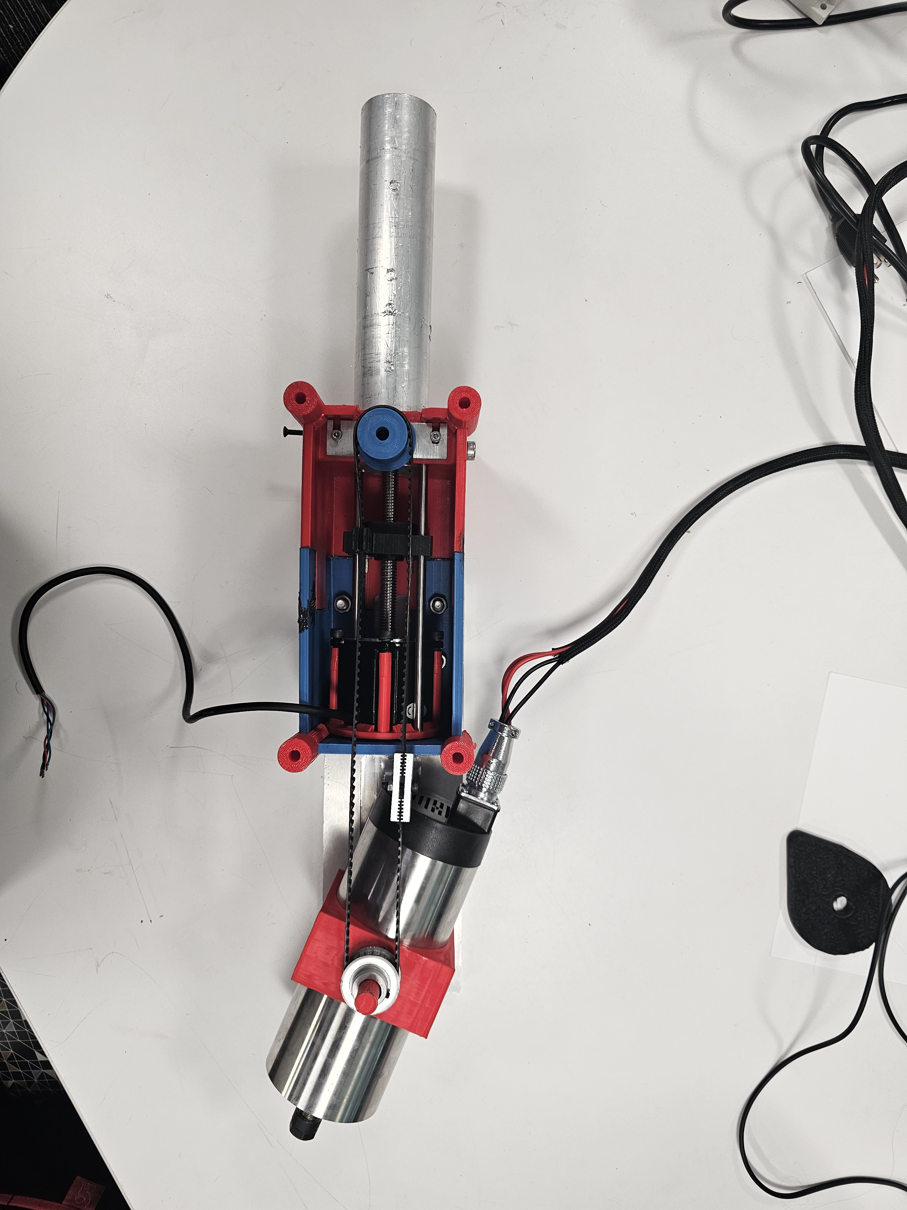
Mathematical Modeling – Joint 5 – Brandon Knutson
Initial Testing with FEA Provided confidence when it came to J6's Aluminum Arm
However, The same FEA didn’t show promising results when it came to the Plastic J6 spindle housing.

Slide 18
Mathematical Modeling – Torque Calculations – Daniel Cooke
Governing Equations and Variables
Eqn (1): RT = m*L*g
Eqn (2): TMAX= T*GBR*SSR
Required Torque (RT): Amount of torque required to achieve sufficient joint movement (N-m)
Torque Output (TMAX): Peak motor torque output (N-m)
Expected Torque Output (T): Expected torque from each motor (N-m)
Gear Box Ratio (GBR): Gear reduction within the planetary gearbox attached to each motor
Second Stage Reduction (SSR): Additional reduction due to pulleys
Mass (m): mass of the joints that each motor is required to move (kg)
Length (L): Length from the motor shaft to the center of gravity of the joint being moved (m)
Gravity (g): 9.81 m/s^2
Standard Gearbox Efficiency: 85%
Joint 1
RT = 25kg*0.5m*2rad/s^2
RT =25 N-m
TMAX = 1.2N-m*10*7.6*.85
TMAX = 77.52 N-m
Joint 2
RT = 22kg*.5m*9.81m/s^2
RT = 107.9 N-m
TMAX = 1.2N-m*50*2.7*.85
TMAX = 137.7 N-m
Joint 3
RT = 14kg*.45m*9.81m/s^2
RT = 61.8 N-m
TMAX = 1.2N-m*50*2*.85
TMAX= 102 N-m
Joint 4
RT = 2kg*.01m*9.81m/s^2
RT = .196 N-m
TMAX = 1.2 N-m
(not geared)
Conclusions
The expected torque output from each motor stage outweighs their respective required torque.
Excluded Factors
Slippage about motor shafts
Friction Losses
Desired acceleration of joints during operation
Loss of tension in timing belts

Slide 19
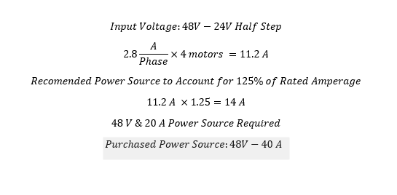
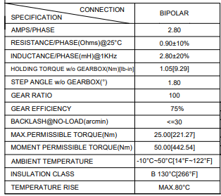
Mathematical Modeling – Electrical – Mason Goodman

Slide 20
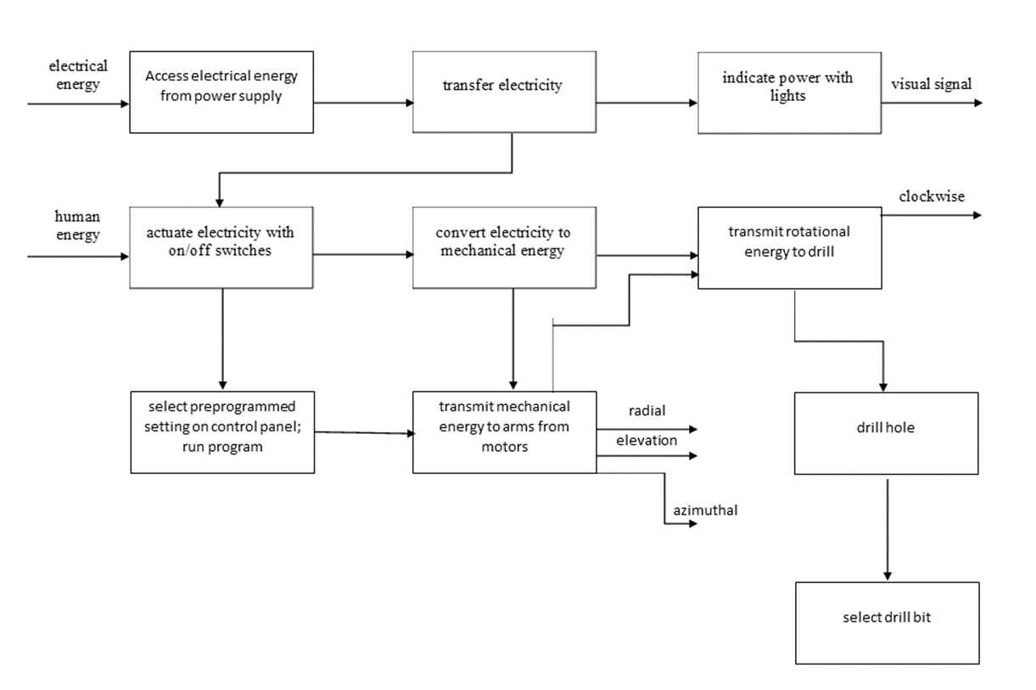
Functional Model

Slide 21
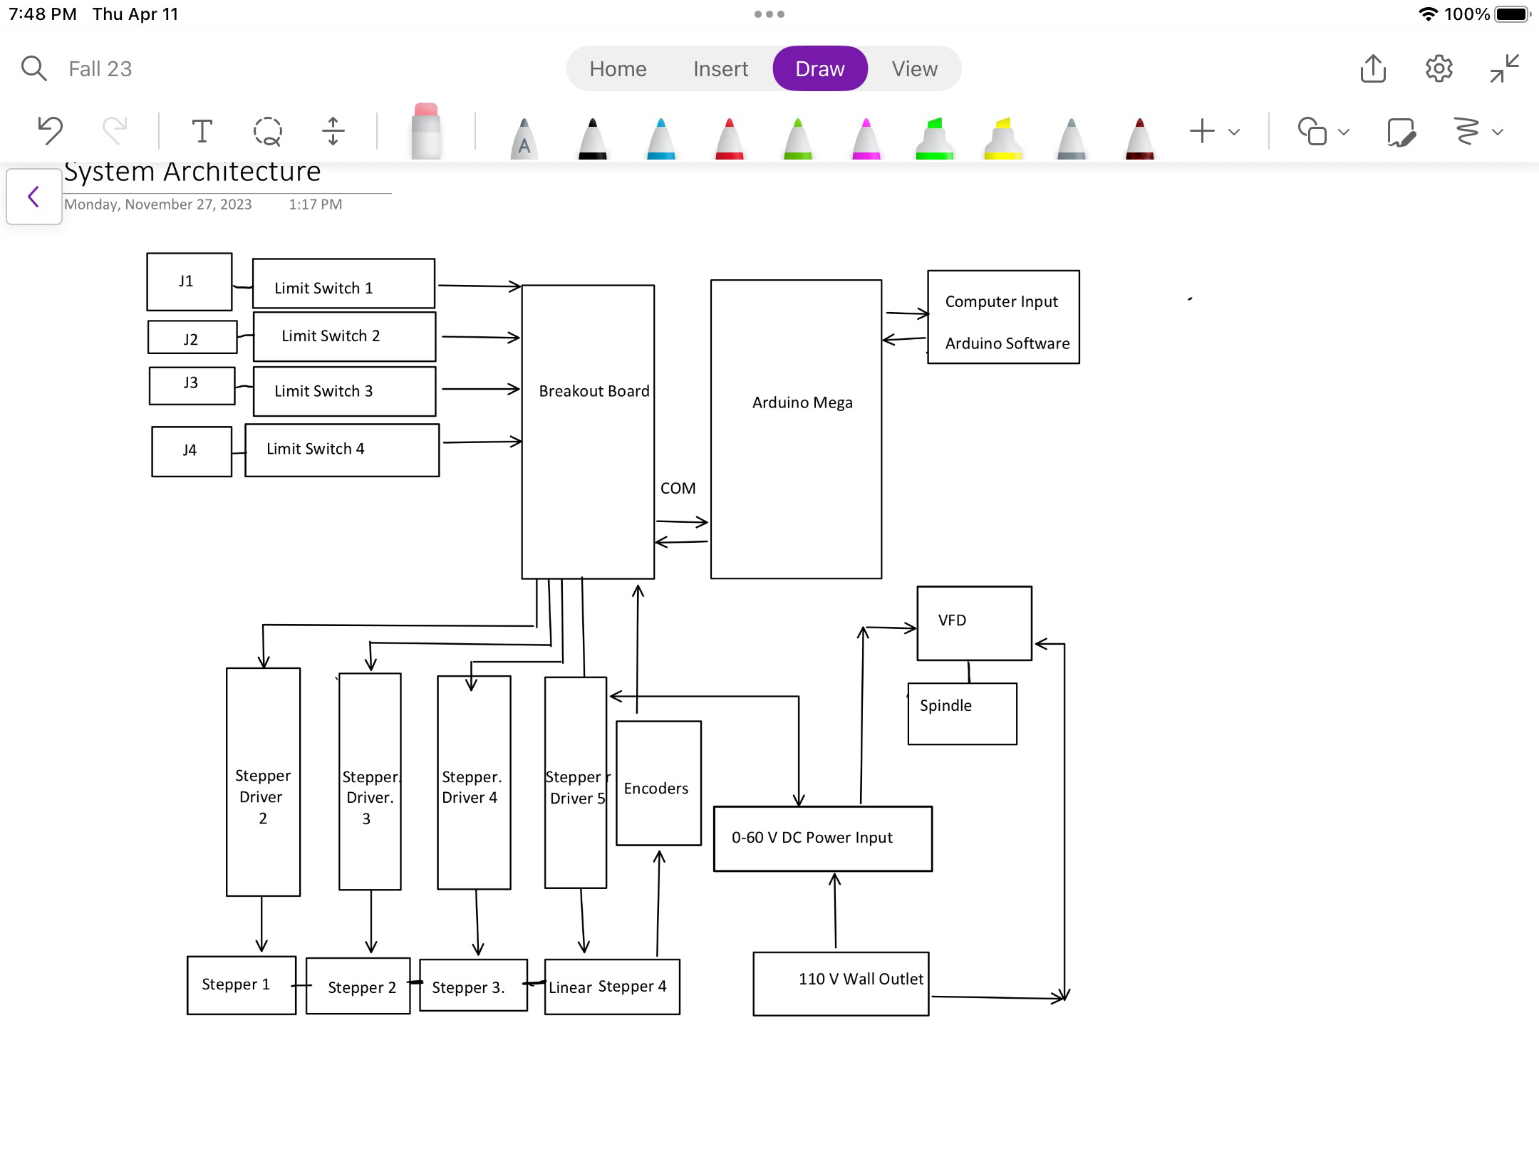
System Block Diagram

Slide 22
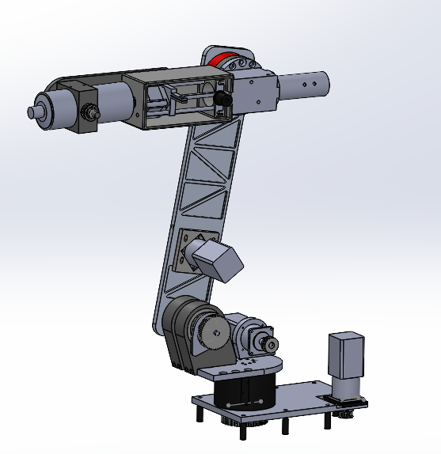
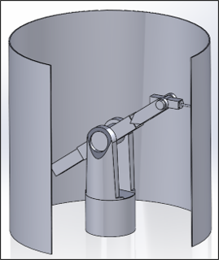
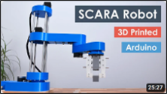
Concept Generation - Top Level
Final Design
3 DOF Robot
Scara Robot
Notes:
Show and describe all applicable top-level and sub-system-level concepts. All other concepts
that were filtered out early in the process can go into the appendix. Discuss initial prs and cons of each concept.

Slide 23
Selection Criteria - Top Level
Motors: Will take up a significant part of our total budget along with gearboxes and supporting items.
Complexity: with limited time, money, experience and tools, limited complexity was vital to the project's feasibility.
Deflection: Our design needs to be accurate and have a high level of repeatability for production assembly.
Documentation: record of others doing similar projects will help us problem solve and give inspiration for our own design.

Slide 24
Concept Selection - Top Level
 | Motors | Complexity | Deflection | Documentation | Totals
Criteria Weight | 1 | 2 | 3 | 4
6 Degree of Freedom | 1 | 2 | 3 | 3
Rating | 1 | 4 | 9 | 12 | 26
3 Degree of Freedom | 3 | 1 | 1 | 1
Rating | 3 | 2 | 3 | 4 | 12
Scara Robot | 2 | 3 | 2 | 2
Rating | 2 | 6 | 6 | 8 | 22

Slide 25
Concept Generation - J1
Design Name | Simplicity | Power Options | Cost | Ordering / Shipping
Slewing Drive | 1st | 1st | 2nd | 2nd
Gear System / Spindle | 2nd | 2nd | 1st | 1st

Slide 26
Concept Generation - J2 and J3
Design Name | Simplicity | Torque Output | Cost | Performance
Belt and Pulley | 1st | 2nd | 1st | 2nd
Chain and Sprocket | 2nd | 1st | 2nd | 1st

Slide 27
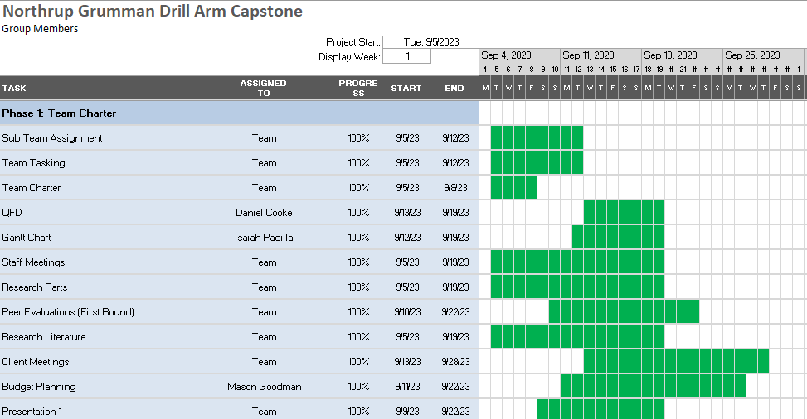
Gantt Chart
 | On Track/Completed
 | Not Started
 | Completed Late

Slide 28
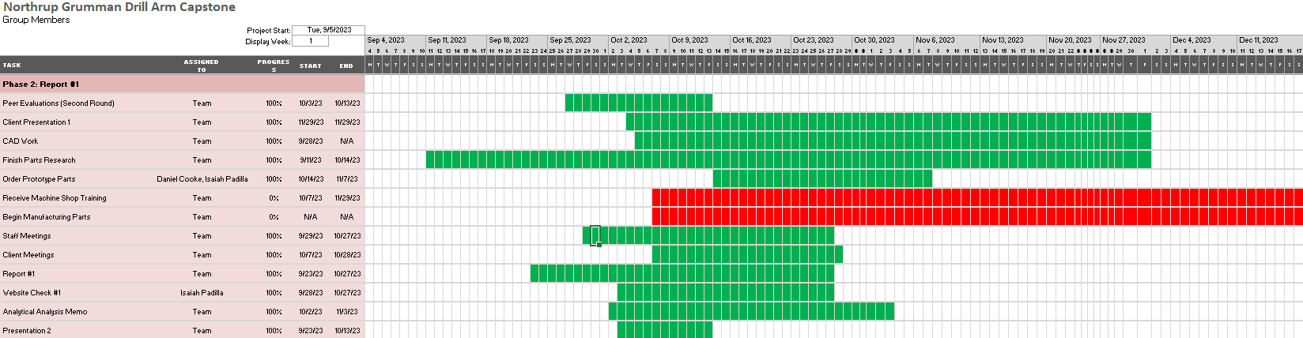
Gantt Chart
 | On Track/Completed
 | Not Started
 | Completed Late
*Despite having reached completion with nearly all objectives by the end of the project now, during the first semester, the team had optional objectives that would ideally have been reached during the first semester but ultimately could not be reached until the second semester. As a result, some red bars occur for certain objectives.

Slide 29
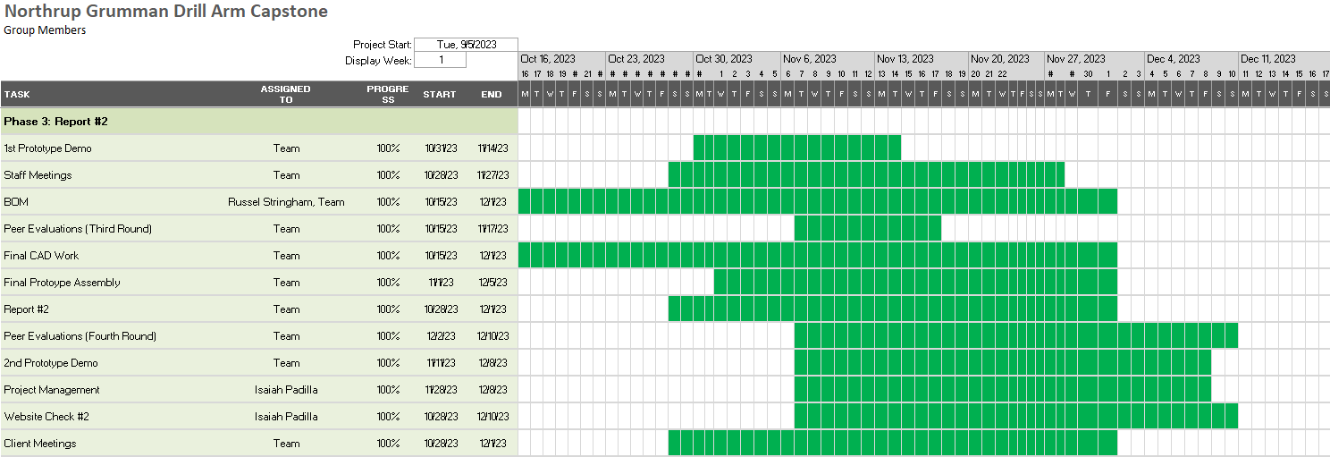
Gantt Chart
 | On Track/Completed
 | Not Started
 | Completed Late

Slide 30
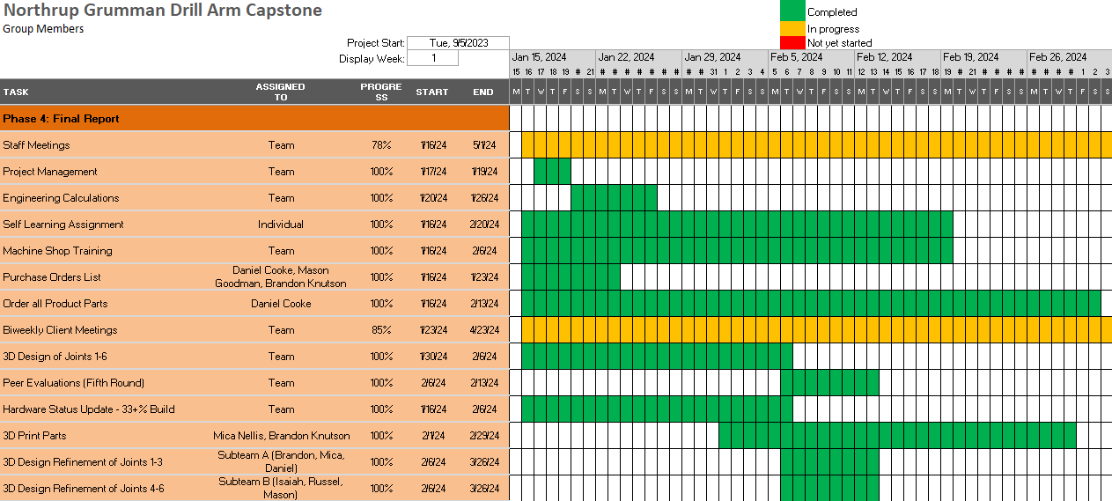
Gantt Chart
 | On Track/Completed
 | Not Started
 | Completed Late

Slide 31
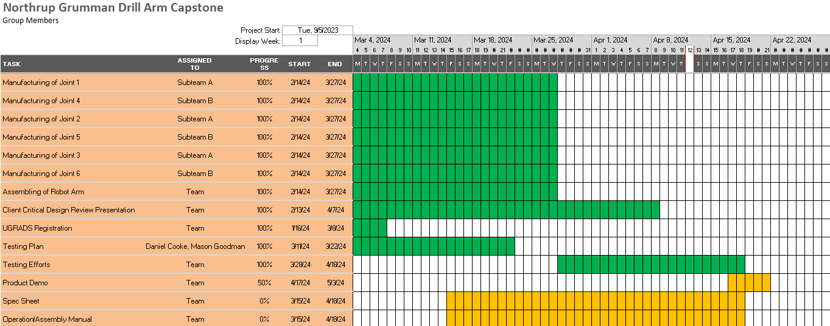
Gantt Chart
 | On Track/Completed
 | Not Started
 | Completed Late

Slide 32
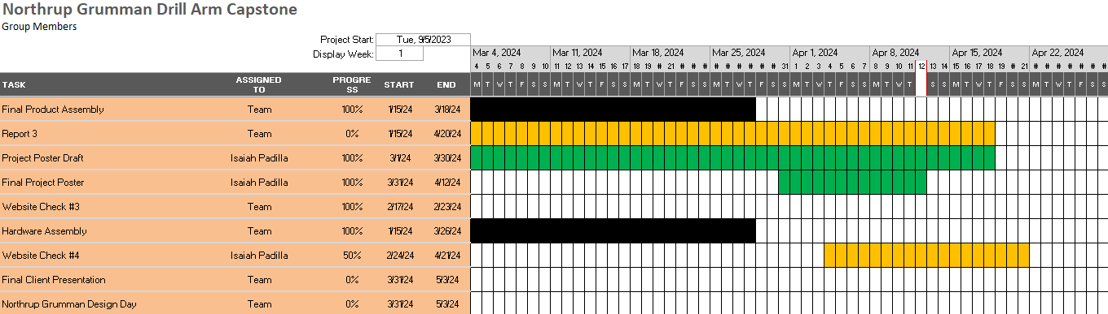
Gantt Chart
 | On Track/Completed
 | Not Started
 | Completed Late

Slide 33
Budget
Final Product Budget
Testing and Prototype Budget
Category | Amount Spent ($)
Raw Materials | 385.49
Motors and Drivers | 660.71
Electrical Components | 798.61
Spindle and VFD | 591.04
Bearings, Belts, Pulleys | 692.14
Hardware | 486.23
Total | $ 3614.22
Category | Amount Spent ($)
Raw Materials | 227.86
Motors | 474.72
Electrical Components | 187.48
Hardware | 54.82
Total | $944.88

Slide 34






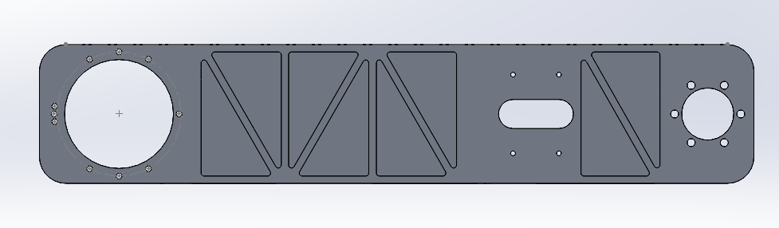
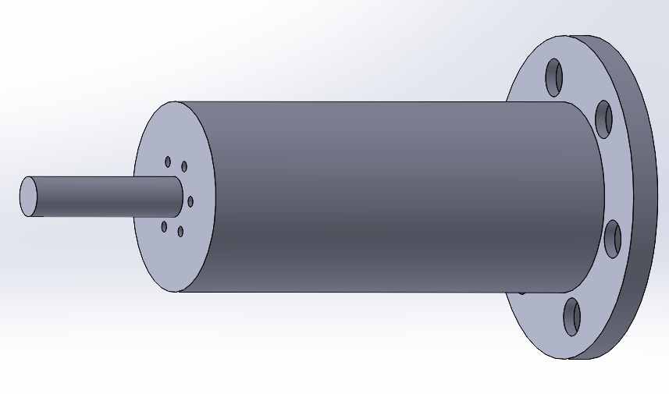


Manufacturing Bill of Materials
Part # | Description | Material | Time to Manufacture | Joint | Picture
1 | Base Plate​ | Aluminum​ | 5 | 1​
2 | Turret Housing​ | PLA​ | 48 | 1​
3 | Spindle​ | Aluminum​ | 8 | 1​
4 | Turret Base​ | Aluminum​ | 4 | 1​
5 | Turret Housing​ | PLA​ | 84 | 2​
6 | Main Arm​ | Aluminum​ | 5 | 2​
7 | Drive Spindle​ | Aluminum​ | 16 | 2​
8 | Tension Ring​ | PLA​ | 1 | 2​
9 | Motor Mount ​ | PLA​ | 1 | 1/3​

Slide 35









Manufacturing Bill of Materials
Part # | Description | Material | Time to Manufacture | Joint | Picture
10 | Motor Supports​ | PLA​ | 1.5 | 2​
11 | Bearing Cup​ | PLA​ | 9 | 3​
12 | Spindle 3​ | PLA​ | 9 | 3​
13 | Spindle 3 Retainer​ | PLA​ | 1 | 3​
14 | Turret Housing 4 | PLA​ | 26 | 4
15 | Main Shaft​ | Aluminum​ | 1 | 4​
17 | Belt Carrier/Clamp​ | PLA​ | 2.8 | 4
18 | Housing​ | PLA​ | 48 | 4
19 | Bearing Post​ | Aluminum​ | 2.8 | 4
Russel Stringham

Slide 36







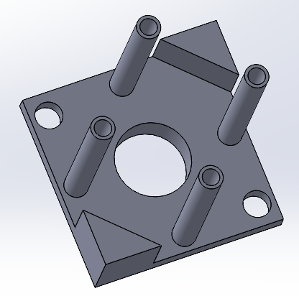
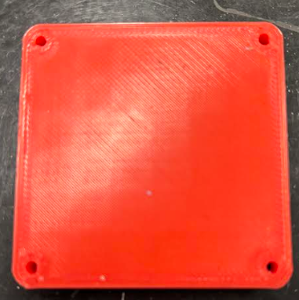
Manufacturing Bill of Materials
Part # | Description | Material | Time to Manufacture | Joint | Picture
20 | Tension Block​ | Aluminum​ | 1 | 4
21 | Bearing Arm​ | Aluminum​ | 10 | 5
22 | Spindle Housing​ | PLA​ | 2.8 | 5
23 | Bearing Cup​ | PLA​ | 1 | 5
24 | Arm Spacer​ | PLA​ | 38 | 2​
25 | Arm Spacer Cover​ | PLA​ | 70 | 2​
26 | Timing Hub​ | PLA​ | 2.8 | 4​
27 | Motor Holder | PLA | 5 | 4
28 | Motor Supports​ | PLA | 2 | 2
Russel Stringham

Slide 37
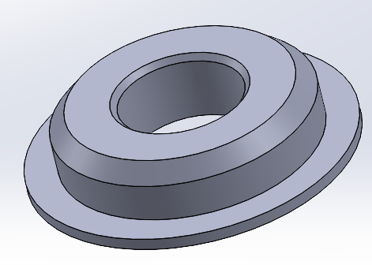
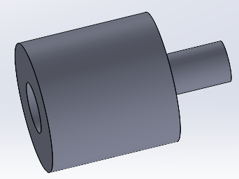
Manufacturing Bill of Materials
Part # | Description | Material | Time to Manufacture | Joint | Picture
29 | Bearing Holder | PLA | 1 | 4
30 | Rod Cup | PLA | 0.5 | 4
Total Manufacture Time | 407.2
Completed Manufacture Time | 407.2
Percent Manufacture Completion (%) | 100.00%

Slide 38
Purchasing Bill of Materials
Part # | Description | Quantity | Price/ unit | Total Price | Vendor
1 | ½’’ Aluminum Plates | 10 ft^2 | 29.57 | 177.43 | Amazon
2 | Aluminum Round Stock | 1ft | 170/ft | 170 | Online Metals
3 | Nema 23 Stepper Motors | 4 | 104.71 | 418.96 | Stepper Online
4 | Nema 17 Stepper Motors | 1 | 170.76 | 170.76 | Stepper Online
5 | Motor Drivers | 6 | 21.29 | 127.74 | Stepper Online
6 | Spindle | 1 | 207.81 | 207.81 | Stepper Online
7 | VFD | 1 | Included | Included | Stepper Online
8 | Buck Converter | 1 | 20.99 | 20.99 | Amazon
9 | Stepper-Driver Cables | 6 | 15.20 | 91.20 | Amazon
10 | 20 AWG Cables (4 colors) | 5m | 14.99 | 14.99 | Amazon
11 | CAT 5 | 1m | 15.99 | 15.99 | Amazon

Slide 39
Purchasing Bill of Materials
Part # | Description | Quantity | Price/ unit | Total Price | Vendor
12 | CAT 6 | 3m | 15.99 | 19.96 | Amazon
13 | Keystone Jack | 1 | 11.62 | 11.62 | Amazon
14 | USBC 90 deg Keystone Jack | 1 | 4.00 | 4.00 | Amazon
15 | USB to USBC cable | 1 | 12.99 | 12.99 | Amazon
16 | Sv limit switch | 5 | .99 | 4.99 | Amazon
17 | Xv limit switch | 1 | 1.29 | 1.29 | Amazon
18 | Power Jack Socket | 1 | 6.99 | 6.99 | Amazon
19 | KCD1 Rocker Switch | 1 | .99 | .99 | Amazon
20 | 3pos double row terminal | 1 | 3.95 | 3.95 | Amazon
21 | Teensy 4.1 | 1 | 36.91 | 36.91 | Amazon
22 | Teensy terminal block | 1 | 23.90 | 23.90 | Amazon

Slide 40
Purchasing Bill of Materials
Part # | Description | Quantity | Price/ unit | Total Price | Vendor
23 | Aviation Plugs | 2 | 2.99 | 5.99 | Amazon
23 | PBS Push Button Switch | 1 | 1.99 | 1.99 | Amazon
24 | Cooling Fan | 1 | 8.95 | 8.95 | Amazon
26 | Braided Sleeve | 25 ft | 25.99 | 25.99 | Amazon
27 | Taper Roller Bearings | 5 | 45.62 | 228.1 | Amazon
28 | Thrust Bearings | 4 | 107.12 | 428.48 | McMaster-Carr
29 | Thrust Washers | 2 | 5.99 | 11.99 | McMaster-Carr
30 | Needle Roller Thrust Bear | 1 | 6.06 | 6.06 | McMaster-Carr
31 | Needle Roller Bearings | 2 | 8.48 | 16.96 | McMaster-Carr
32 | Deep Groove Ball Bearing | 1 | 11.97 | 11.97 | McMaster-Carr
33 | 60T XL Pulley/ Belt | 1 | 31.88 | 31.88 | Amazon

Slide 41
Purchasing Bill of Materials
Part # | Description | Quantity | Price/ unit | Total Price | Vendor
34 | 214-L Timing Belt | 1 | 22.69 | 22.69 | Amazon
35 | L10 Pulleys | 2 | 9.58 | 19.16 | Amazon
36 | XL 15tth 8mm Pulley | 2 | 9.99 | 19.99 | Amazon
36 | XL 10tth 6mm bore pulley | 2 | 6.98 | 13.96 | Amazon
37 | Shafts (3mm*85mm) | 2 | 2.75 | 5.50 | Amazon
38 | Bushings | 2 | 5.99 | 11.99 | Amazon
39 | Hardware/ Unexpected Purchases | 1 | Expected | 300 | Amazon
41 | Cabinet Dolly | 1 | 98.96 | 98.96 | ULINE
Total Parts: 41 (excluding multiples of parts)
Total Spent: 4614.88 (excluding tax and shipping)
Percent Purchased: 100%
Remaining Budget: $2385.12
Fundraised Amount: $895.00

Slide 42
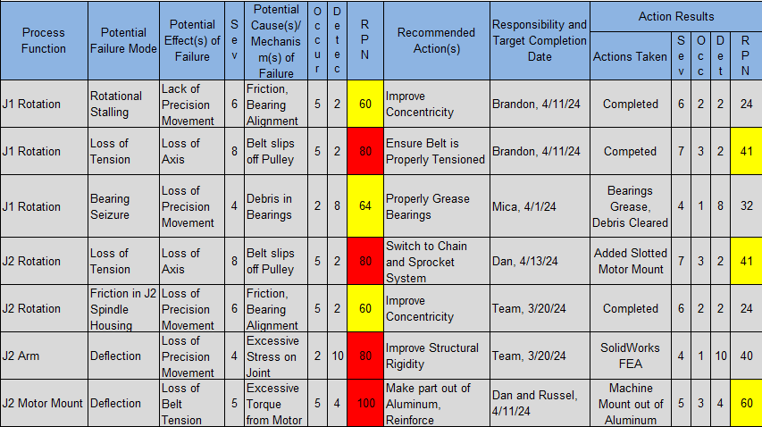
Failure Modes and Effects Analysis: Joints 1 and 2
Main Points of Concern
Loss of tension in timing belts
Deflection of motor mounts which causes motor chatter and belt tension loss

Slide 43
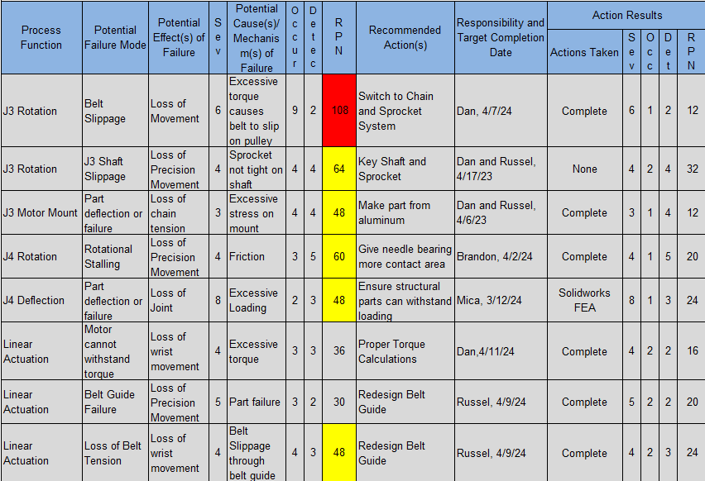
Failure Modes and Effects Analysis: Joints 3 and 4
Main Points of Concern
Belt slippage
Shaft rotation
Stalling due to friction
Belt guide rigidity

Slide 44
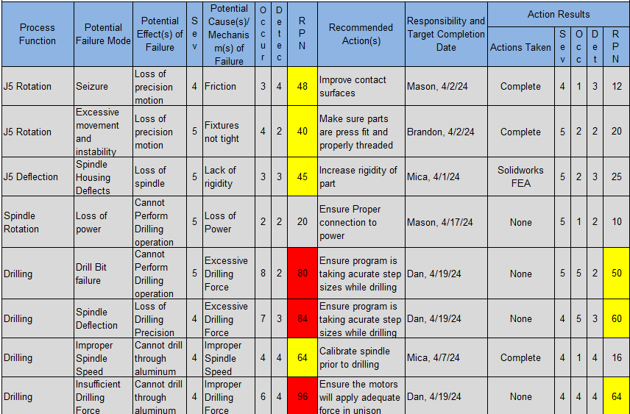
Failure Modes and Effects Analysis: Joint 5 and Spindle
Main Points of Concern
Loss of precise wrist rotation
Obtaining precise movement from all motors to perform the drilling operation
Snapping drill bits

Slide 45
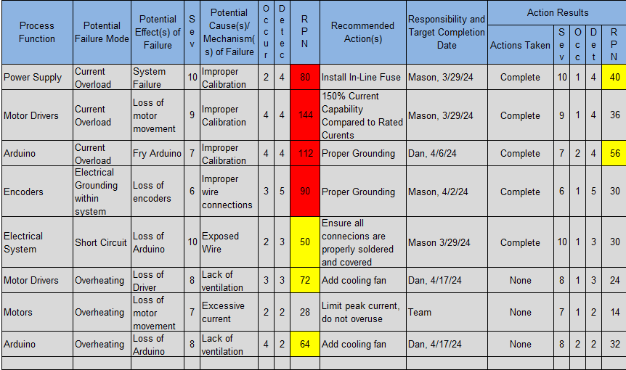
Failure Modes and Effects Analysis: Electrical Components
Main Points of Concern
Excessive current from power supply
Unstable wire connections
Overheating within electrical box

Slide 46
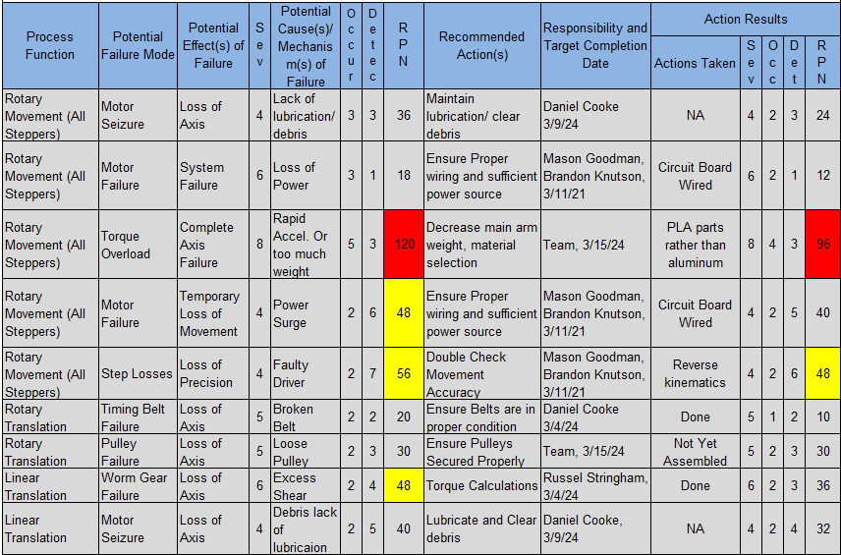
Failure Modes and Effects Analysis: Individual Motor Stages
Main Points of Concern
Torque overload while joints are moving
Step Losses leading to decreased movement accuracy

Slide 47
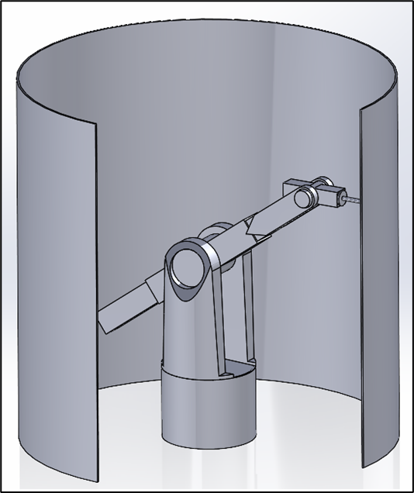
Design Prototype One
Objective of the Design: Can a robotic drill arm be constructed without becoming a complete 6DOF arm?
Result: Ultimately it made the design more challenging and limited the team greatly in terms of options and design freedom.
It was decided to redesign completely after this design iteration.
Future design sought to improve on rotation capability and strength of drill action.

Slide 48
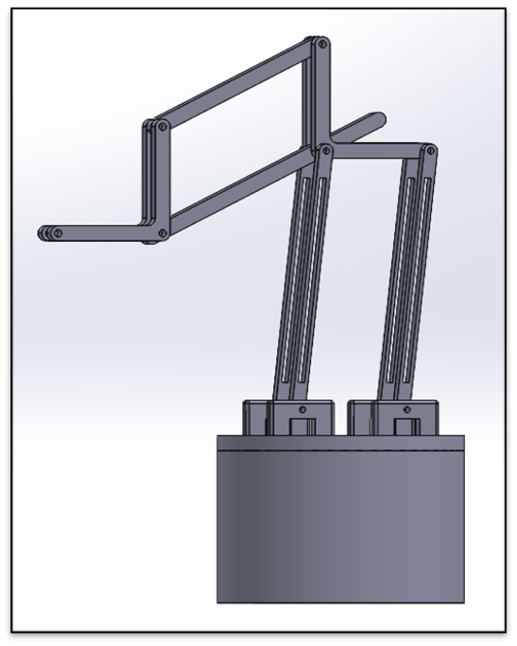
Design Prototype Two
Objective of the Design: Can a robotic drill arm be constructed through use of only a few Degrees of Freedom?
Result: This design effort did greatly improve simplicity of the design and helped make the calculations less complicated.
This design iteration was fully implemented into a working prototype but also ultimately was forgone for a better design eventually.
Future design sought to improve on DOF capability and to solve the continuing issue of rotation.

Slide 49
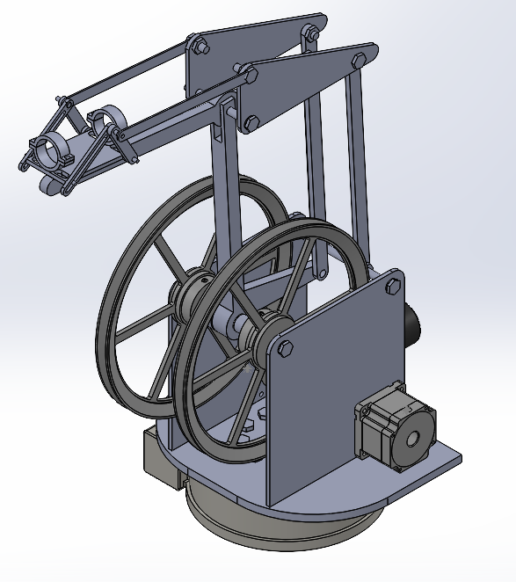
Design Prototype Three
Objective of the Design: Can a robotic drill arm be constructed with the use of multiple pulley systems to improve efficiency?
Result: This design effort culminated in a design which worked but presented many issues with the base rotation, requiring a very expensive part to move.
It was decided to redesign completely after this design iteration. This design iteration never made it to a physical prototyping stage.
Future design sought to improve on maneuverability and rotation capability.

Slide 50
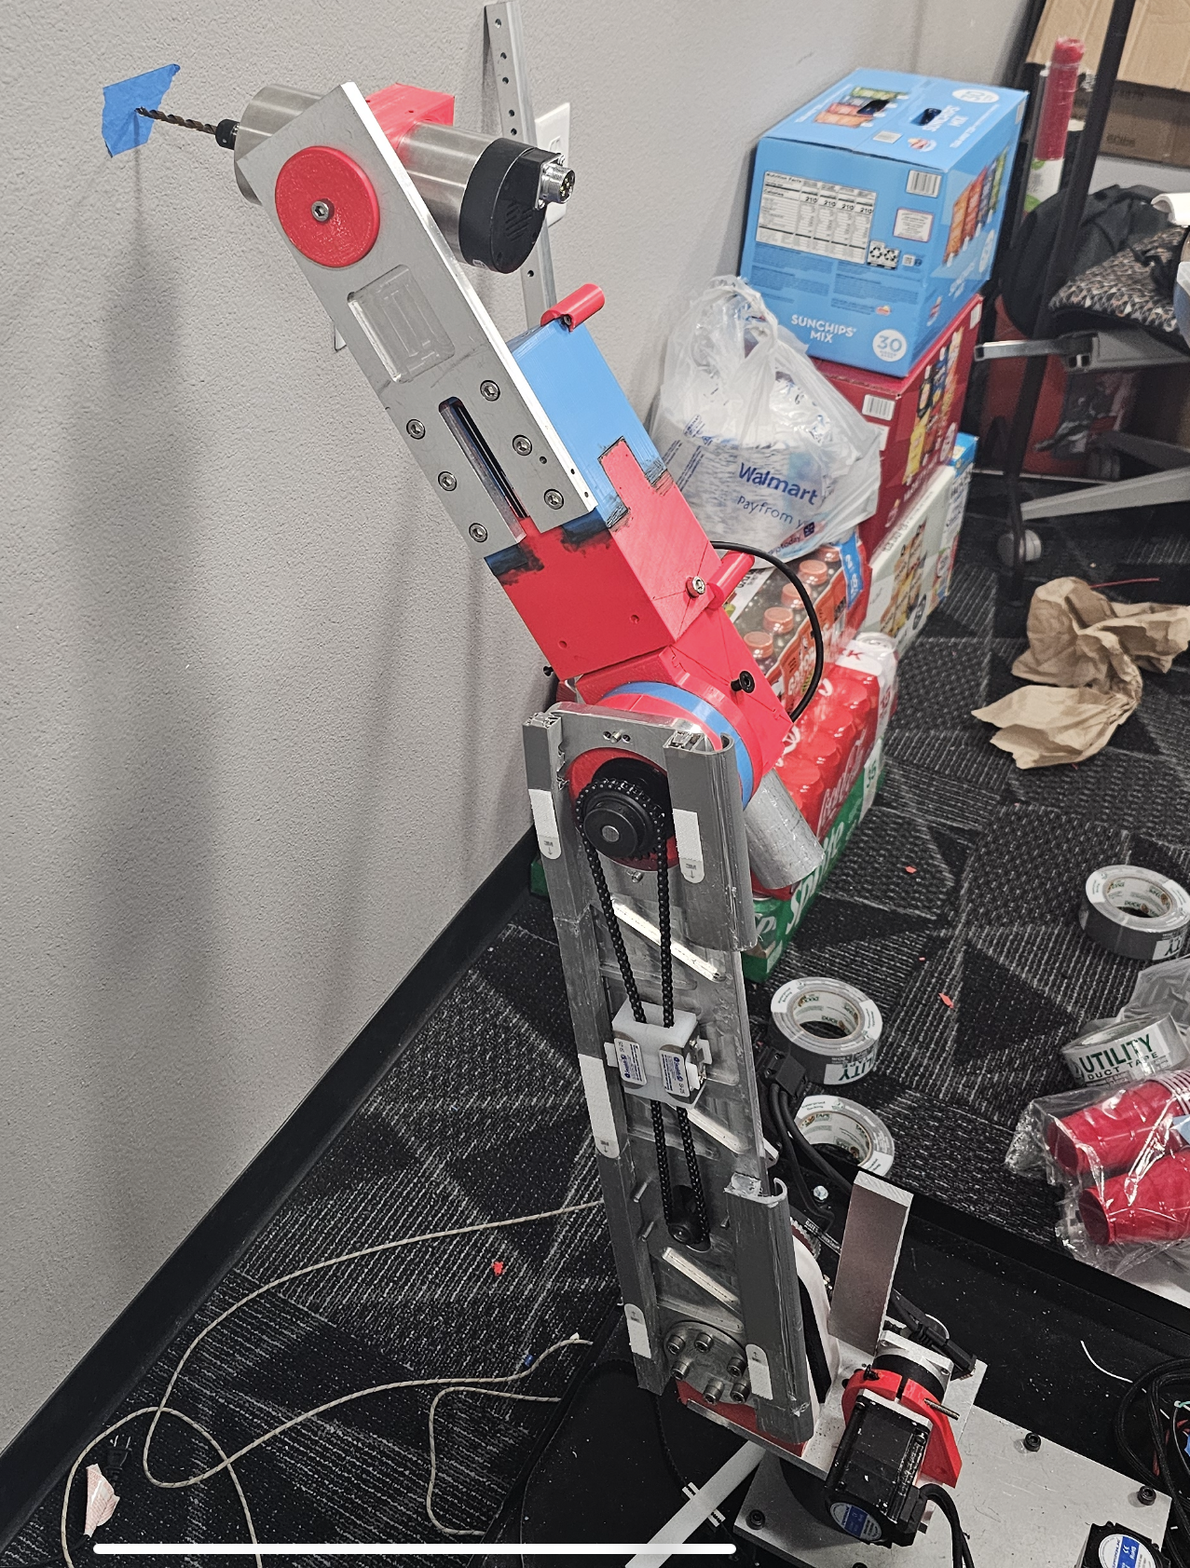
Final Hardware – Full Assembly

Slide 51
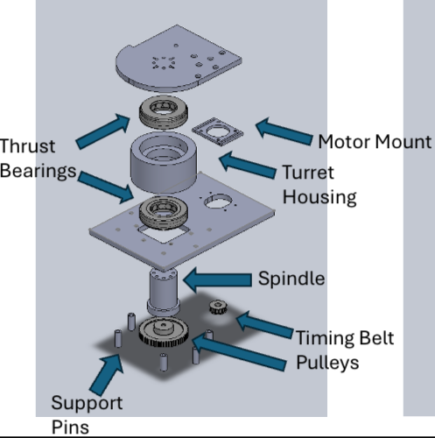
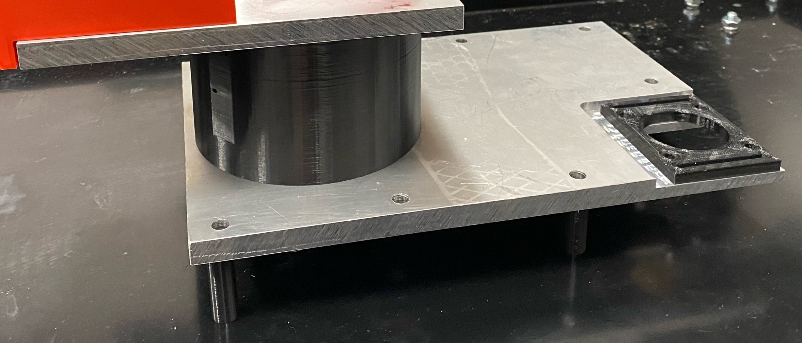
Final Hardware – Joint 1

Slide 52
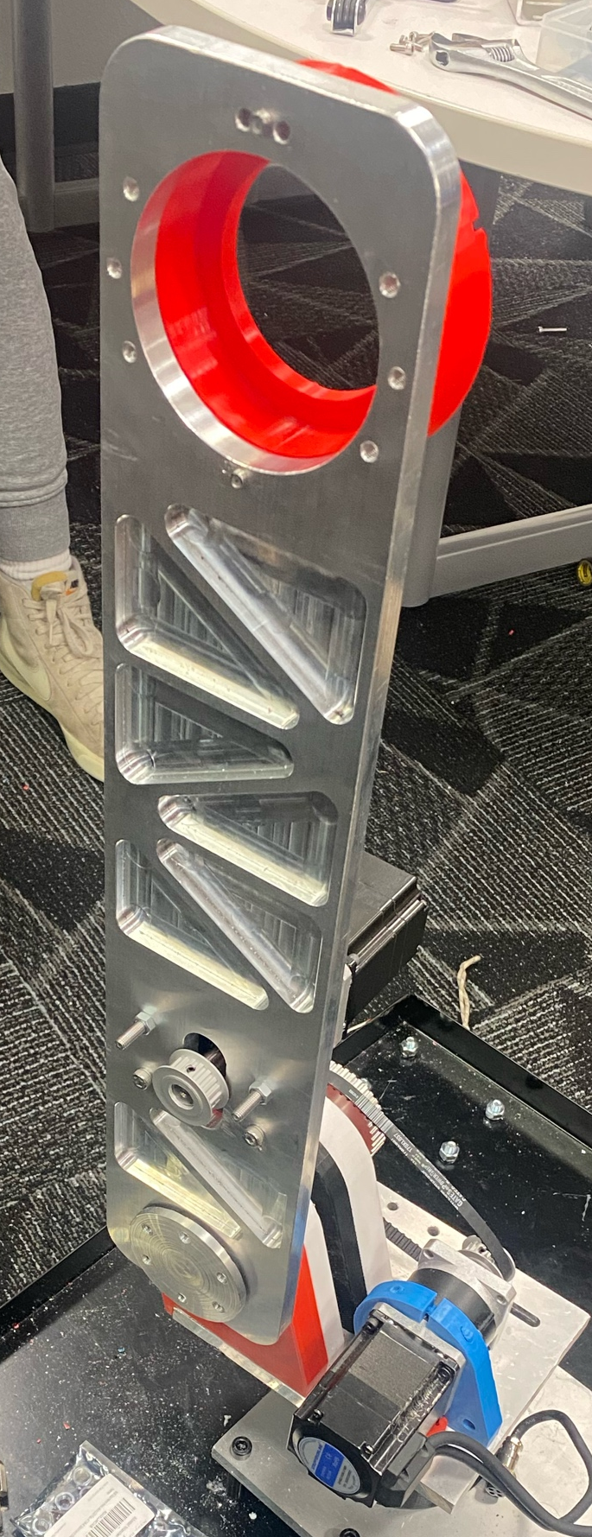
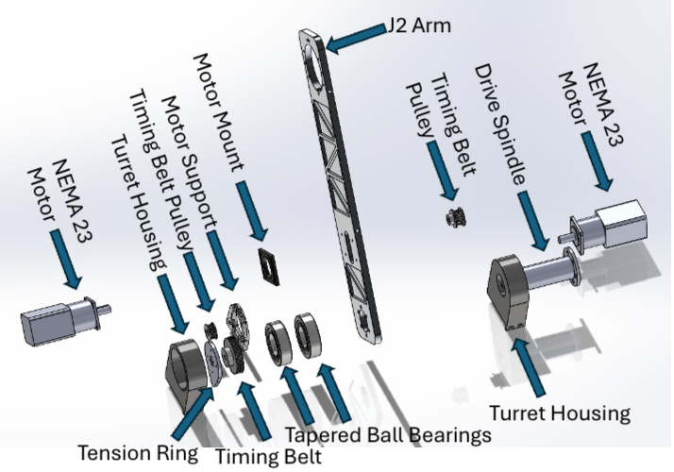
Final Hardware – Joint 2

Slide 53
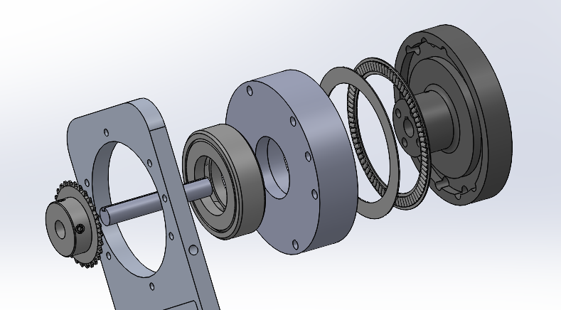
Final Hardware – Joint 3
Needle Roller Bearing Washer
J2 Arm
Thrust Bearing
Spindle
Needle Roller Bearing
Sprocket
Bearing Cup
Key Shaft

Slide 54
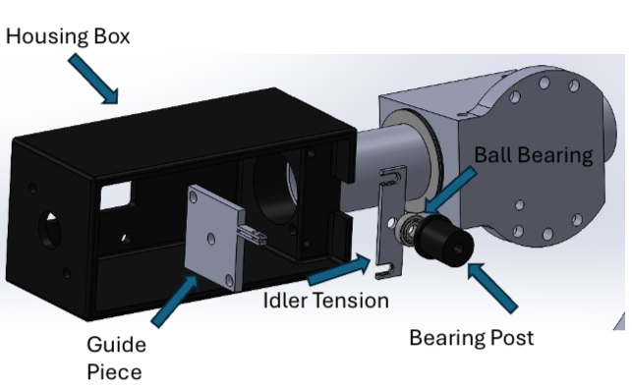
Final Hardware – Joint 4

Slide 55

Final Hardware – Joint 5

Slide 56


Final Hardware – Electrical Box

Slide 57
TOP LEVEL TESTING DESIGN SUMMARY
Test Plan |  |  |  |  |  |  |  |  | Test Report
Specification | Unit Under Test | Test Description | Relevant DR's | Acceptance Criteria | Target Requirements | Test Responsibility | Test Equipment | Est. Completion | Act. Completion | Test Notes | Pass/Fail | Course of Action
J1 – J4 Motor Amperage | J1 - J6 Motors | Provide varied "Loads" in the form of hand resistance up until shortly before stall torques to understand general amperage pull compared to that of rated currents for each motor | CR 6 – Electrical Pwr CR 7 – Emergency Stop | Motors do not exceed an amperage reading of 10 A to ensure protection of J1 - J6 Motor Drivers | All Must Pass | Mica / Brandon | J1 - J6 Motors, Variable Power Supply, 10 A Motor Driver, 20 AWG wire, AWM 2586 Wire, Arduino Software | 8-April | 7-April | Power, efficiency, amperage, behaved as expected | Pass | N/A
Spindle Wiring & Rpm | End Effector | Wire the end effector in unison with the Varaible Frequency Drive to ensure purchased wiring is adequate and the Rpm's of the end effector can be adjusted | CR 2 – ¼ “ Al Drilling CR 7 – Emergency Stop ER 2 - Spindle Speed | End effector runs and has variable Rpm capabilities for wood/aluminum to guarantee future testing capabilities | All Must Pass | Mica / Brandon | 10 A Spindle, VFD, Variable Power Supply, AWM 2586 Wire | 8-April | 8-April | Spindle speed was able to reach the desired 3000 rpm with 50 Hz of power | Pass | N/A
Refined Joint Displacement | Complete Robotic Design | Robotic design can move in the X,Y, and Z planes as intended | CR1 - Working Vol CR2 – ¼” Al Drilling CR3 - HIR CR4 – Drilling Tolerance CR5 – Portable CR6 – Electrical Power CR7 – Emergency Stop CR8 – Cost Efficient ER1 – Deflects < 0.1” ER2 – Spindle Speed ER3 – Motor Torque ER4– HIR ER5 – Assembly < 150 lbs | Joints can complete task movements at various extensions for 10 minutes | Minimum Viable Product | Whole Team | J1 - J6 Motors, Variable Power Supply, 10 A Motor Driver, 20 AWG wire, AWM 2586 Wire, Limit Switches, J1 - J6 Manufactured Parts, Roller Dolly, Complete Hardware, Arduino Software | 16-April-19-April | 25-Mar - 9-April | All motors behave as expected with the exception of J2 | Pass | N/A
Real World Simulation | Complete Robotic Design | A real world simulation where the design moves in multiple planes & completes drilling operations | All - Reference Above | Movement is continuous & complete with a finished drilling operations that meets CR's | Minimum Viable Product | Whole Team | J1 - J6 Motors, Variable Power Supply, 10 A Motor Driver, 20 AWG wire, AWM 2586 Wire, Limit Switches, J1 - J6 Manufactured Parts, Roller Dolly, Complete Hardware, Arduino Software | 23-April | 9-April – 22 - April | Robot behaved as needed and completed acts of drilling | Pass | Refine precision movement

Slide 58



Testing Plan – Torque Speed Curves
Set Speed and delivered step pulses with an Arduino Micro.
Tested Motors with weights for a range of speeds
Repeated with the motor and Gearbox and just the motor.

Slide 59

Testing Plan – Power Efficiencies
Values for 15 to 180 RPM | Motor W/ Gearbox | Motor W/O Gearbox | Stepper Online Data Sheet
Average Torque (NM) | 6.82 NM | 0.7871 | 5.70
Peak Power (Watts) | 121 | 14.8 | 66.75
Theoretical Motor W/ Gearbox output: 7.871 NM
Found Motor W/ Gearbox output: 6.82NM
Our Findings...
2 stage Gearbox efficiency is 87%
3 stage Gearbox efficiency is 81%
Stepper Online States
2 stage Gearbox efficiency is 85%
3 stage Gearbox efficiency is 75%

Slide 60
Testing Plan – Spindle Speed
Summary:
Wire the end effector in unison with the Variable Frequency Drive (VFD) to ensure purchased wiring is adequate and the Rpm’s of the end effector can be adjusted
Testing ER2 - Spindle speed of 3000 RPM
Procedure:
Power on VFD to 10 Hz increase in increments of 10 until 100 Hz is reached
Measure spindle speed in rounds per minute (RPM) at each increment
Verify that 50 Hz outputs 3000 RPM
Results: Pass

Slide 61

Testing Plan – Refined Joint Displacement (Dan)
Goals
Document tendencies of individual joints while moving
Determine ideal settings within the programmable software
Identify points of failure for each moving joint
Materials Required: Robot Assembly, AccelStepper for Arduino IDE, properly wired and coded motor drivers.
Procedures
Determine the desired range of motion required for each joint to move while maintaining the working volume.
Calculate the required microsteps from the individual motor's pulse per revolution setting, gear box ratio, and second stage reduction ratio.
Write code within AccelStepper to loop an individual motor at the desired speed and travel settings.
Beginning with J1, measure angular displacement and document irregular movement, stalling, and potential points of joint failure
Once desired range of motion has been achieved for each individual motor, repeat step for while operating two joints in unison.
Repeat until all four motors can move in unison without failure.
Individual Motor Movement Test Results

Slide 62
Testing Plan – Real World Simulation
Goal: Robot will perform drilling operation at eight predetermined locations.
Requirements Tested
CR1: Working Volume
CR2: Drills Through ¼’’ Aluminum
CR3: Human Input Responsive (HIR)
CR4: .003’’ Drilling Tolerance
ER1: Deflects < 0.1’’ During Drilling
ER2: Spindle Speed: 3,000 RPM
ER3: Motor Torque: 100 N-m
ER4: HIR
Materials Needed
Complete Assembly of Robot
(2) ¼’’ Aluminum Plates
Testing Jig
Arduino Program
Procedures
Secure aluminum plates to testing jig, one at a height of 2 foot from the ground, the other at a height of 4 feet.
Write IDE code that controls the end effector.
Establish a square bolt hole pattern for each plate, with each hole being 1.5 inches apart.
Set spindle speed to 3,000 rotations per minute.
Reset robot joints to “home” location.
Run program.
Expectations
Robot should be able to perform entire drilling operation without any human interference once the program has commenced.
Four holes should be drilled at the expected locations in each plate with little error.
Team will document time to complete operation, significant deflections, and any error with the movement of each joint.
Test will be conducted until the results are customer acceptable.
Results: Test not yet conducted

Slide 63
Specification Sheets – Customer Requirements
Customer Requirement | CR met (Y/N) | Client Acceptable (Y/N)
CR 1 - Working Volume (50" D, 4' Height ) | Yes | Yes
CR 2 - 1/4" Aluminum Drilling | Yes | Yes
CR 3 - Human Input Responsive | Yes | Yes
CR 4 - .003" Drilling tolerance | No | TBD
CR 5 - Portable | Yes | Yes
CR 6 - Electric Power | Yes | Yes
CR 7 - Emergency Stop | Yes | Yes
CR 8 - Cost Efficient | Yes | Yes

Slide 64
Specification Sheets – Engineering Requirements
Engineering Requirement | Target | Tolerance | Measured Value | ER met (Y/N) | Client Acceptable (Y/N)
ER 1 - Deflects < .1'' during drilling | .1'' | -.1'' | .25” | No | TBD
ER 2 - Spindle Speed 3000 Rpm | 3000 RPM | +/- 200 RPM | 3029.4 RPM | Yes | Yes
ER 3 - Motor Torque 100 N-m | 100 N-m | +/- 2 N-m | +/- 2 N-m | Yes | Yes
ER 4 - Human Input Responsive | Yes | N/A | N/A | Yes | Yes
ER 5 - Assembly < 150 lbs | 150 Lbs | +/- 10 Lbs | ~ 110 lbs | Yes | Yes

Slide 65
Future Work
Programming
Create program capable of taking G-code files as an input
Create an interface to make programming the robot more user friendly
Drilling Operation
Integrated coolant spout
Redesign joints to be able to reach varying working volumes
Design to drill in any direction, not just parallel to the ground
Allow for spindle to change drill bits for varying hole sizes
Structural
Replace 3D printed parts with aluminum to increase structural rigidity
What would the team do differently?
Perform more extensive research on electrical requirements and available programming software
Design from the “bottom-up”, rather than designing individual joints simultaneously
Revise belt and pulley calculations
Perform extensive FEA on parts to determine the material required for manufacture
Calculate torque requirements for varying arm positions while considering friction losses and desired arm acceleration
Consider alternative options to the air-cooled spindle to decrease weight
Implement better DFMA tactics throughout the design process
Thoroughly evaluate options prior to execution

Slide 66
References
[1] “Robotstudio target external axis,” kasaplet. https://kasaplet.weebly.com/robotstudio-target-external-axis.html (accessed Oct. 08, 2023).​
[2] “SCARA Robot | How To Build Your Own Arduino Based Robot,” www.youtube.com. https://www.youtube.com/watch?v=1QHJksTrk8s (accessed Oct. 20, 2022).​
[3] “3D Printed Robots: The Most Advanced Projects of 2021,” All3DP, Sep. 11, 2021. https://all3dp.com/2/3d-printed-robot-print-robots/​
[4] R. G. Budynas and J. K. Nisbett, “Chapter 9 - Welding, Bonding, and the Design of Permanent Joints,” in Shigley’s Mechanical Engineering Design, 11th edition, SI units, 11th ed, S.l., NY: MCGRAW-HILL EDUCATION (AS, 2020, pp. 485–612
[5] R. G. Budynas and J. K. Nisbett, “Chapter 4 - Deflection and Stiffness,” in Shigley’s Mechanical Engineering Design, 11th edition, SI units, 11th ed, S.l., NY: MCGRAW-HILL EDUCATION (AS, 2020, pp. 173–219
[6] G. R. Reddy and V. K. Eranki, “Design and Structural Analysis of a Robotic Arm,” thesis, Karlskrona, 2016
[7] R. Gautam, A. Gedam, A. Zade, and A. Mahawadiwar, Review on Development of Industrial Robotic Arm. International Research Journal of Engineering and Technology, 2017
[8] M. Z. Silva, T. Brito, J. L. Lima and M. F. Silva, "Industrial Robotic Arm in Machining Process Aimed to 3D Objects Reconstruction," 2021 22nd IEEE International Conference on Industrial Technology (ICIT), Valencia, Spain, 2021, pp. 1100-1105, doi: 10.1109/ICIT46573.2021.9453596.
[9] M. Fairchild, “Drilling robots: Automate for fast and precise results,” #HowToRobot, https://howtorobot.com/expert-insight/drilling-robots (accessed Sep. 15, 2023).
[10] T. Xometry, “Drilling machines - parts, types, and uses,” Xometrys RSS, https://www.xometry.com/resources/machining/drilling-machines/ (accessed Sep. 15, 2023).
[11]“A-Z guide for Drilling Aluminium | RUKO Shop UK,” RUKO UK, Nov. 07, 2023. https://ruko.shop/blogs/ruko-shop-blog/drilling-aluminium-guide#:~:text=A%20regular%20HSS%20drill%20bit
[12] Matthew, “The Difference Between HSS and Cobalt Drill Bits,” R.D. Barrett, Nov. 20, 2019. https://rdbarrett.co.uk/blog/the-difference-between-hss-and-cobalt-drill-bits/
‌[13] “How to Find the Right High-Speed Spindle | Spindle Tooling,” www.ibagnorthamerica.com. https://www.ibagnorthamerica.com/blog/how-to-select-the-right-high-speed-spindle (accessed Oct. 10, 2023).
[20] R. G. BUDYNAS, “Gears- General,” in Shigley’s Mechanical Engineering Design, 11th ed, MCGRAW-HILL EDUCATION, 2019
[21] W. D. Callister and D. G. Rethwisch, “Mechanical Properties of Metals,” in Materials science and engineering: An introduction, 10th ed, Milton, QLD: John Wiley and Sons Australia, Ltd, 2021
[22] T. J. Baumeister, E. A. Avallone, and T. I. Baumeister, Standard Handbook for Mechanical Engineers, 7th ed. New York: McGraw-Hill Book, 1978.
[23] A. Bicchi and G. Tonietti, “Fast and ‘soft-arm’ tactics,” IEEE Robotics &amp; Automation Magazine, vol. 11, no. 2, pp. 22–33, 2004. doi:10.1109/mra.2004.1310939
[24] S. G. Yakovlev, J. K. Keldibekov, and I. M. Gorbachenko, “Software development for 3D visualization of G-code when working with CNC machines,” Journal of Physics: Conference Series, vol. 1515, no. 2, p. 022082, 2020. doi:10.1088/1742-6596/1515/2/022082
[25] “What is manufacturing & Manufacturing Processes,” Engineering Product Design, https://engineeringproductdesign.com/knowledge-base/manufacturing-processes/ (accessed Sep. 17, 2023).
[26] “Browse Catalog,” McMaster-Carr, https://www.mcmaster.com/ (accessed Sep. 17, 2023).
[27] T. Seo, G.-P. Jung, and D. Yun, Advances in Bio-Inspired Robots. S.l. Units: MDPI AG, 2021. Journals/Articles

Slide 67
References
[28] “Speed - torque curves for Stepper Motors,” Oriental Motor U.S.A. Corp., https://www.orientalmotor.com/stepper-motors/technology/speed-torque-curves-for-stepper-motors.html (accessed Nov. 29, 2023).
[29] B. J. Goodno and J. M. Gere, “Chapter 8: Deflection of Beams,” in Mechanics of Materials, vol. 11th, Australia: Cengage, 2021
[30] Springer Handbook of Robotics: With 84 Tables
[31] Chapter 11 – Implementation, in Engineering by design
[32] Development of Robotic Arm Prototype - A. Chaudhari, K. Rao, K. Rudrawar, P. Randhavan and P. Raut,
[33] A Review of Current Techniques for Robotic Arm Manipulation and Mobile Navigation - T. Sieusankar and B. Chandrasekaran, T. Sieusankar and B. Chandrasekaran
[34] Design of Geometric-Based Inverse Kinematics for a Low-Cost Robotic Arm - M. A. Muslim and S. N. Urfin
[35] The Demeter Project - How to Create a Robotic Arm With Your Students
[36] “Simplify Robot Programming with G-code - Universal Robots,”
[37]“Appendix E: Creating the validation plan with a validation requirements matrix,” NASA, https://www.nasa.gov/reference/appendix-e-creating-the-validation-plan-with-a-validation-requirements-matrix/ (accessed Nov. 29, 2023).
[38] P. Eskofier, “Drv8825 Adjust stepper current,” my home fab, https://www.my-home-fab.de/en/documentations/technical-descriptions/drv8825-adjust-stepper-current (accessed Nov. 14, 2023).
[39] “Three golden rules for choosing a power supply (no maths!) - tutorial australia,” Core Electronics, https://core-electronics.com.au/guides/power-supply-which-to-choose/ (accessed Nov. 29, 2023).

